Slide 1
Chapter 12 GUI Components: Part 1
Java How to Program, 10/e

Slide 2
12.1 Introduction
A graphical user interface (GUI) presents a user-friendly mechanism for interacting with an application.
Pronounced “GOO-ee”
Gives an application a distinctive “look-and-feel.”
Consistent, intuitive user-interface components give users a sense of familiarity
Learn new applications more quickly and use them more productively.

Slide 3
12.1 Introduction (cont.)
Built from GUI components.
Sometimes called controls or widgets—short for window gadgets.
User interacts via the mouse, the keyboard or another form of input, such as voice recognition.
IDEs
Provide GUI design tools to specify a component’s size, location and other attributes in a visual manner by using the mouse, keyboard and drag-and-drop.
Generate the GUI code for you.
Greatly simplify creating GUIs, but each IDE has different capabilities and generates different code.

Slide 4
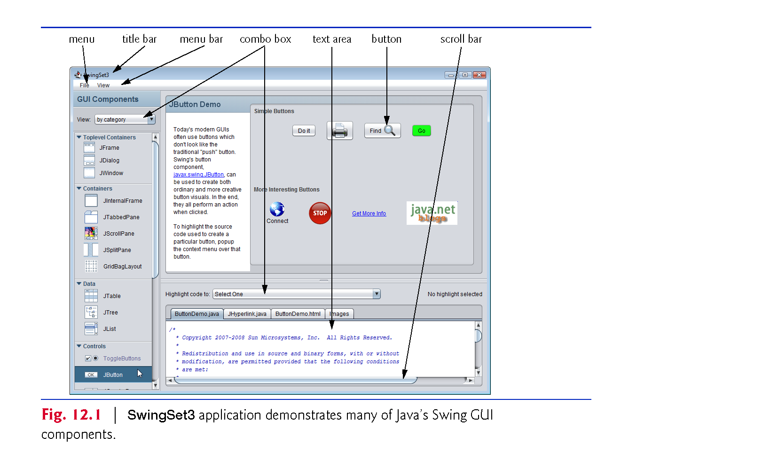

Slide 5
12.4 Overview of Swing Components
Swing GUI components located in package javax.swing.
Abstract Window Toolkit (AWT) in package java.awt is another set of GUI components in Java.
When a Java application with an AWT GUI executes on different Java platforms, the application’s GUI components display differently on each platform.
Together, the appearance and the way in which the user interacts with the application are known as that application’s look-and-feel.
Swing GUI components allow you to specify a uniform look-and-feel for your application across all platforms or to use each platform’s custom look-and-feel.

Slide 6
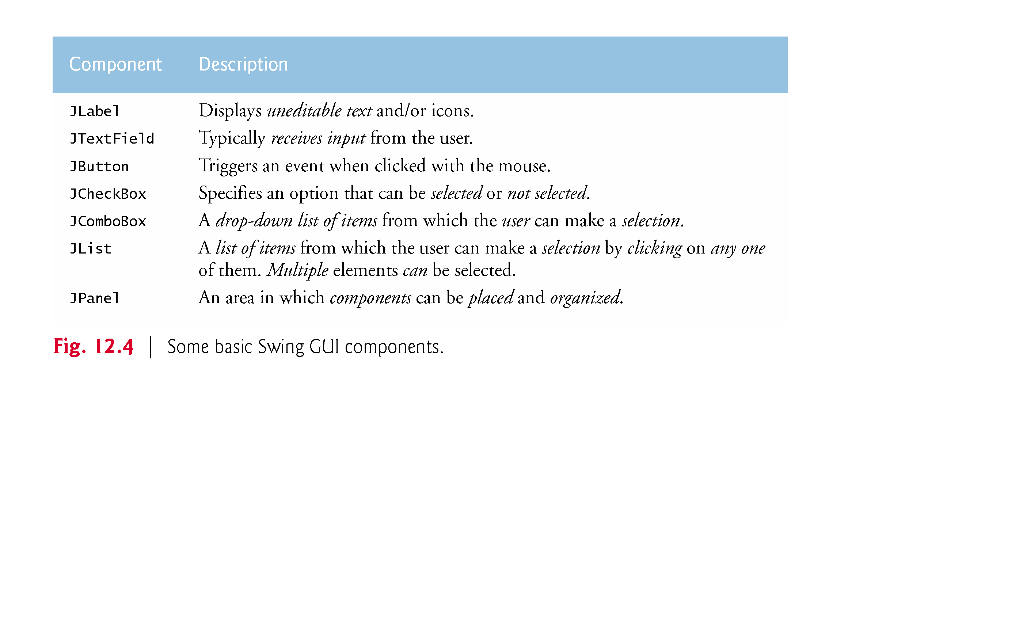

Slide 7
12.4 Overview of Swing Components (cont.)
Most Swing components are not tied to actual GUI components of the underlying platform.
Known as lightweight components.
AWT components are tied to the local platform and are called heavyweight components, because they rely on the local platform’s windowing system to determine their functionality and their look-and-feel.
Several Swing components are heavyweight components.

Slide 8
12.4 Overview of Swing Components (cont.)
Class Component (package java.awt) declares many of the attributes and behaviors common to the GUI components in packages java.awt and javax.swing.
Most GUI components extend class Component directly or indirectly.

Slide 9
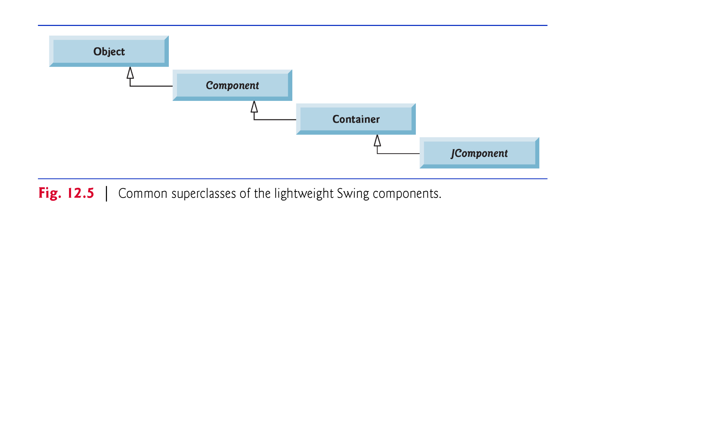

Slide 10
12.5 Displaying Text and Images in a Window
Most windows that can contain Swing GUI components are instances of class JFrame or a subclass of JFrame.
JFrame is an indirect subclass of class java.awt.Window
Provides the basic attributes and behaviors of a window
a title bar at the top
buttons to minimize, maximize and close the window
Most of our examples will consist of two classes
a subclass of JFrame that demonstrates new GUI concepts
an application class in which main creates and displays the application’s primary window.

Slide 11
12.5 Displaying Text and Images in a Window (cont.)
In a large GUI
Difficult to identify the purpose of every component.
Provide text stating each component’s purpose.
Such text is known as a label and is created with class JLabel—a subclass of JComponent.
Displays read-only text, an image, or both text and an image.

Slide 12
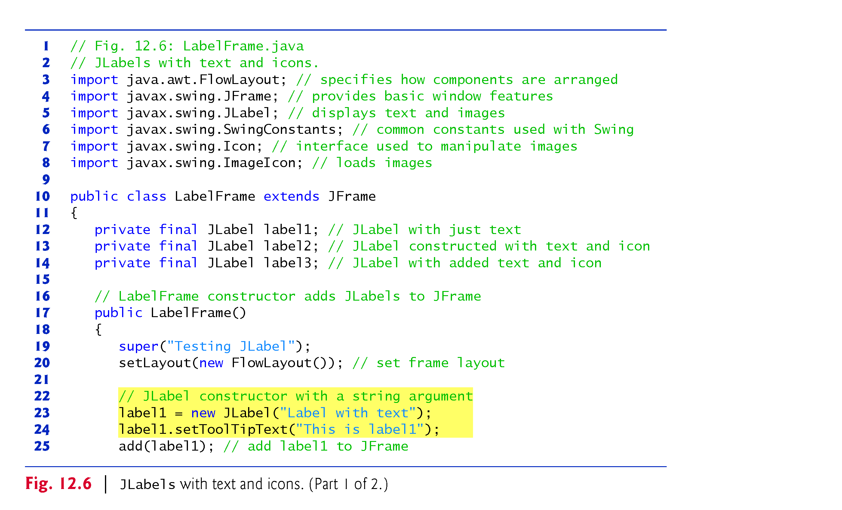

Slide 13
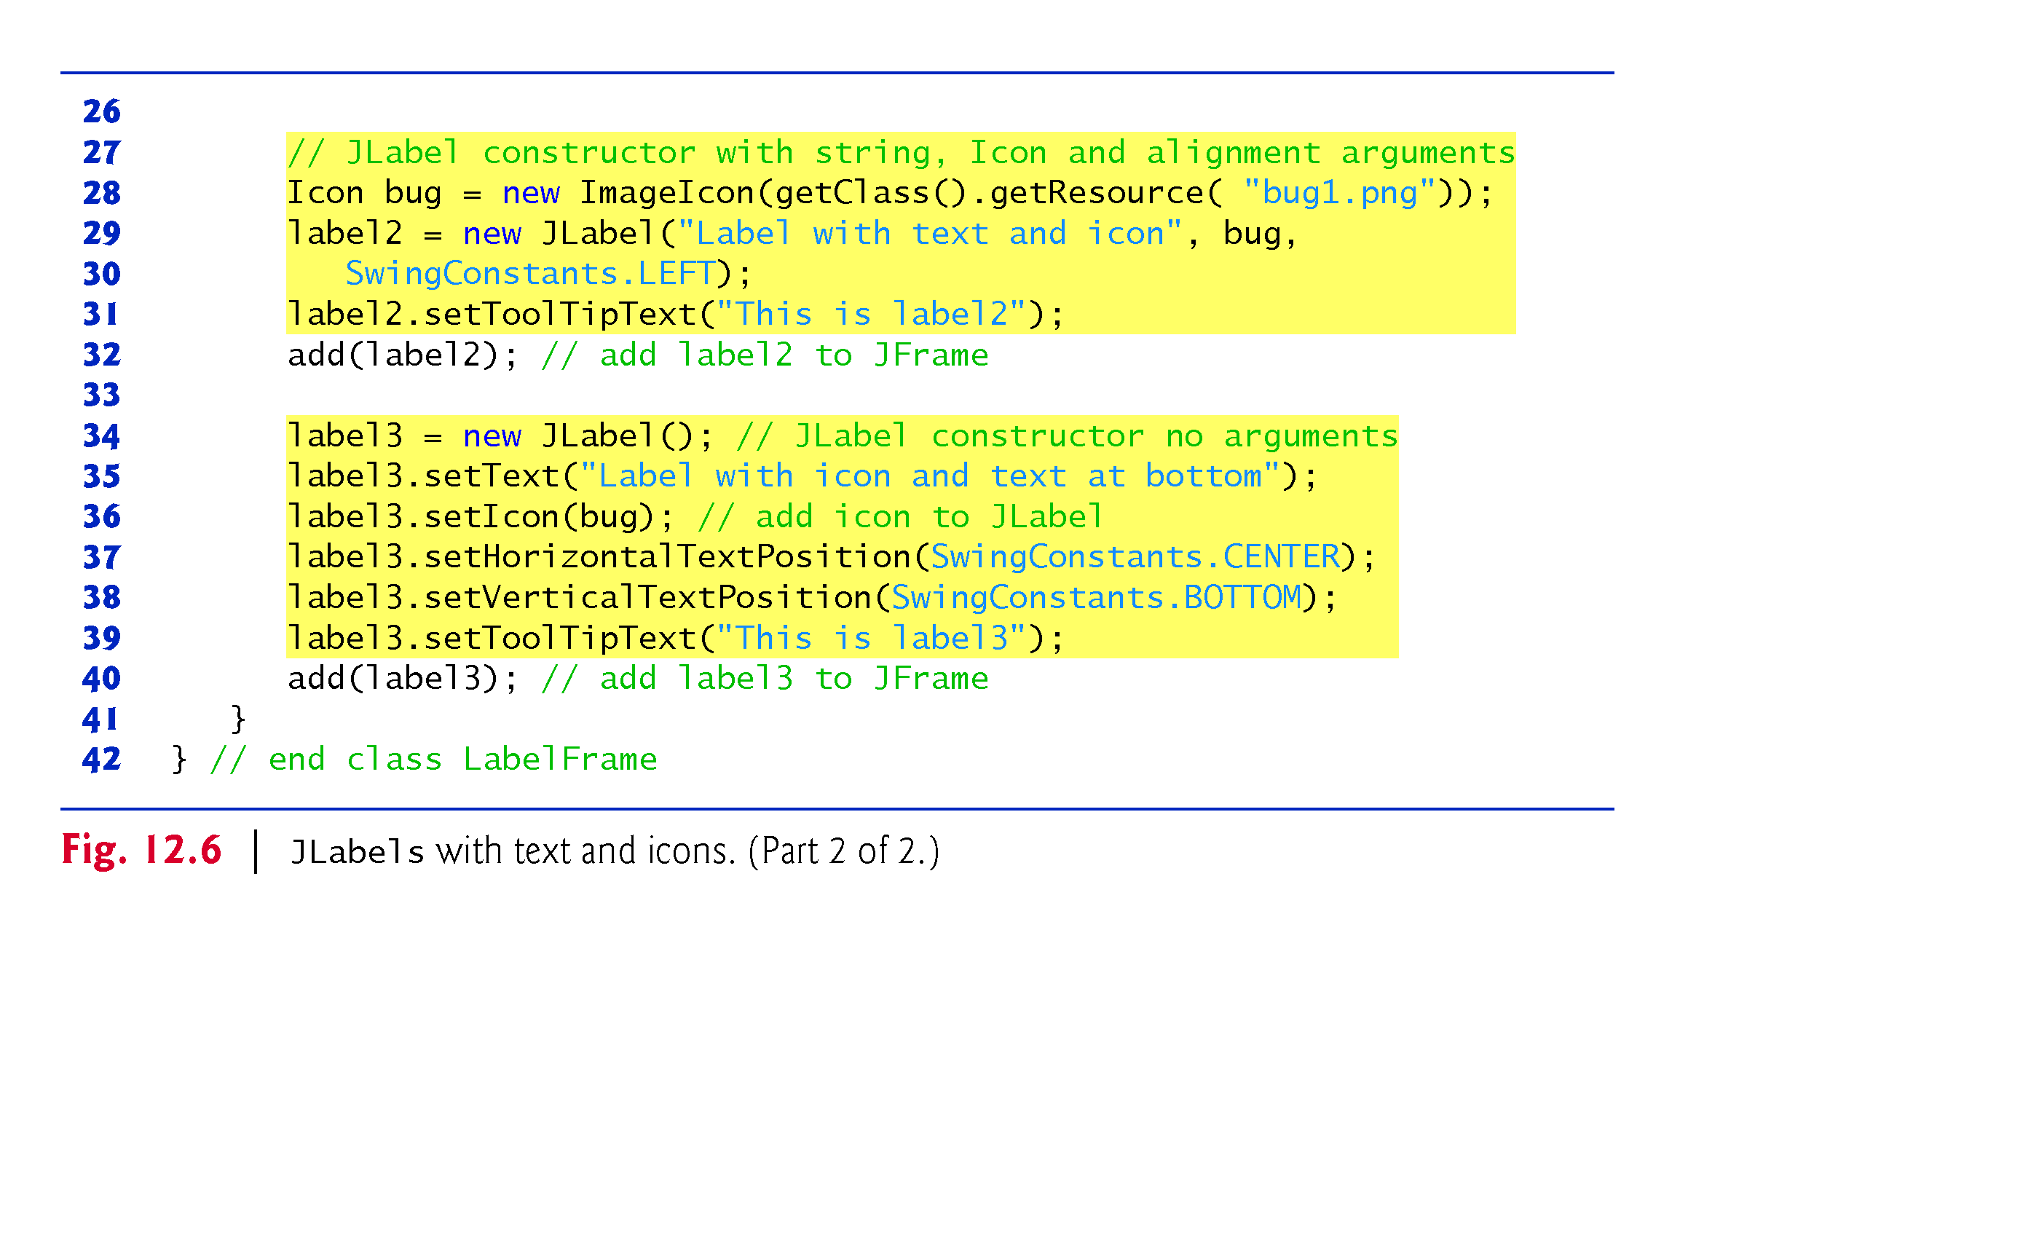

Slide 14
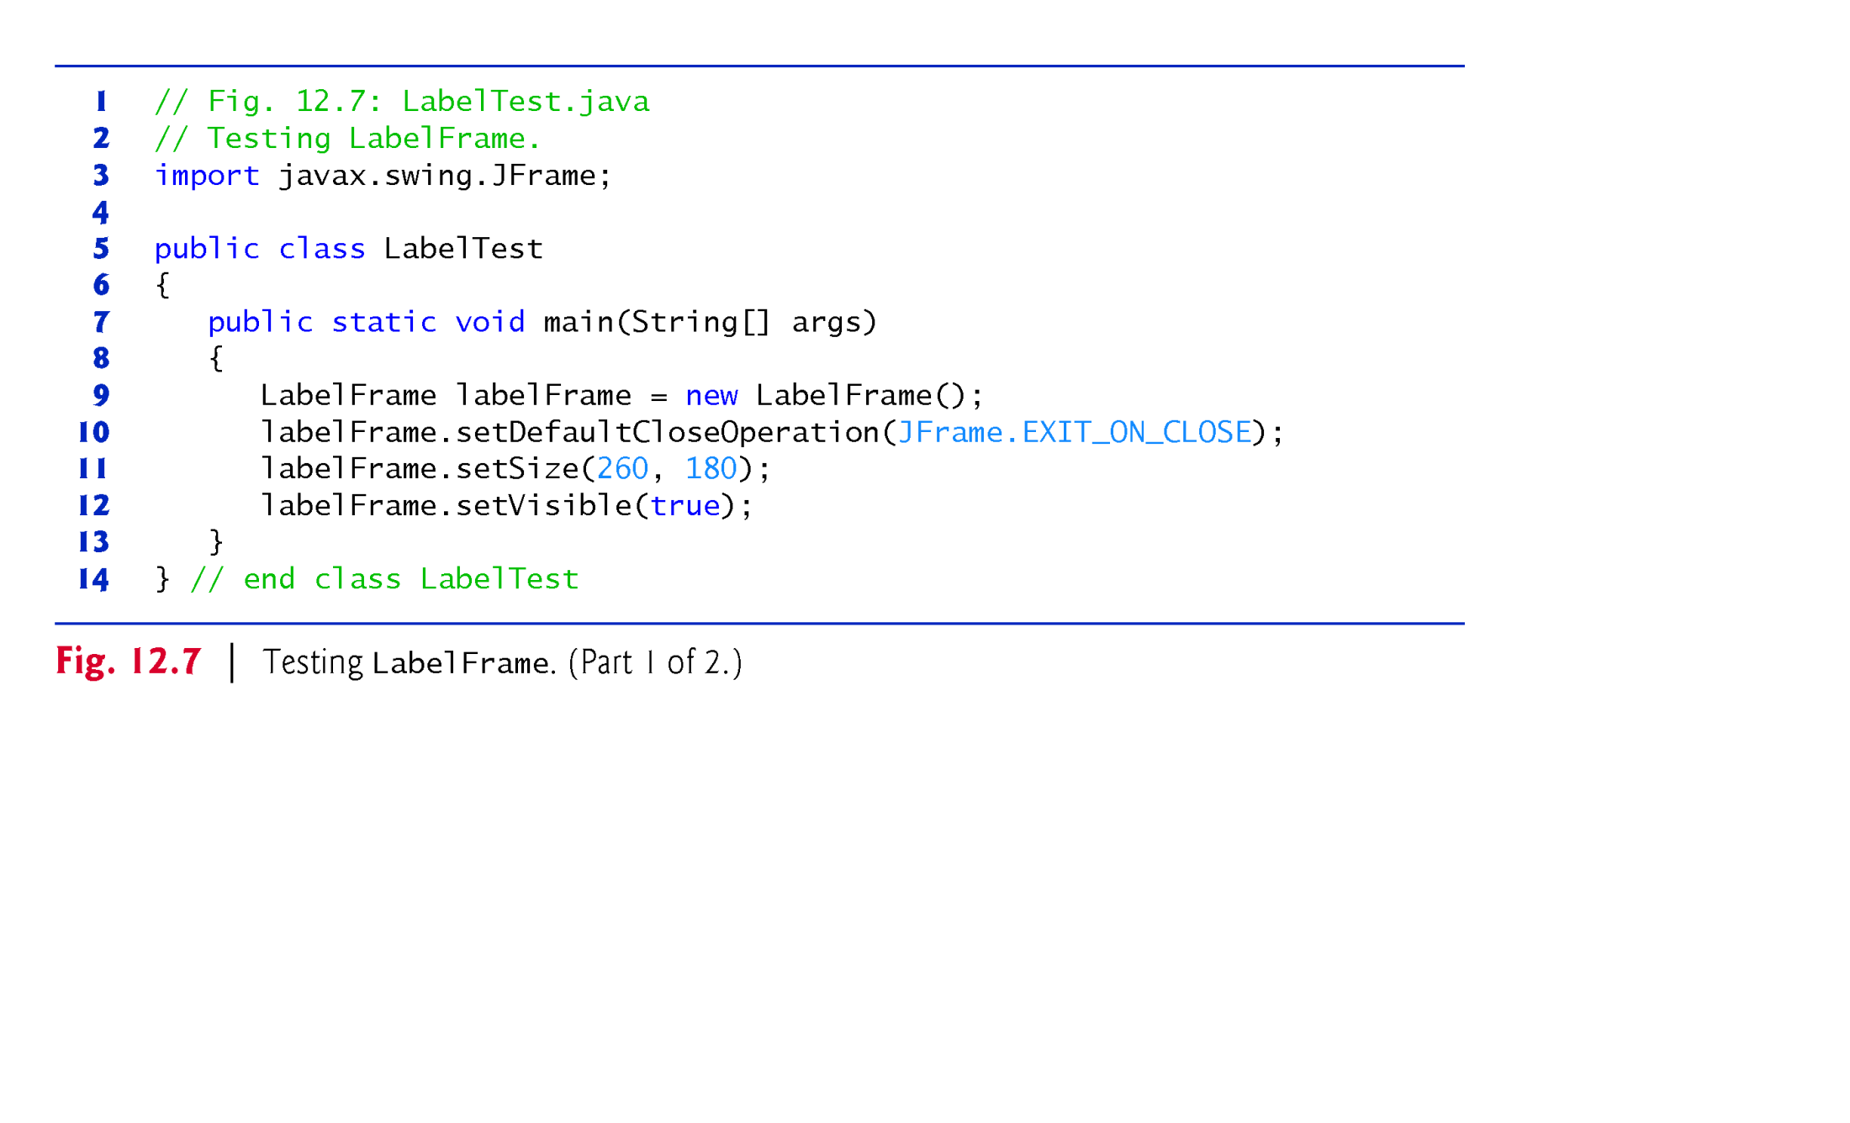

Slide 15
12.6 Text Fields and an Introduction to Event Handling with Nested Classes
GUIs are event driven.
When the user interacts with a GUI component, the interaction—known as an event—drives the program to perform a task.
The code that performs a task in response to an event is called an event handler, and the process of responding to events is known as event handling.

Slide 16
12.6 Text Fields and an Introduction to Event Handling with Nested Classes (cont.)
JTextFields and JPasswordFields (package javax.swing).
JTextField extends class JTextComponent (package javax.swing.text), which provides many features common to Swing’s text-based components.
Class JPasswordField extends JTextField and adds methods that are specific to processing passwords.
JPasswordField shows that characters are being typed as the user enters them, but hides the actual characters with an echo character.

Slide 17
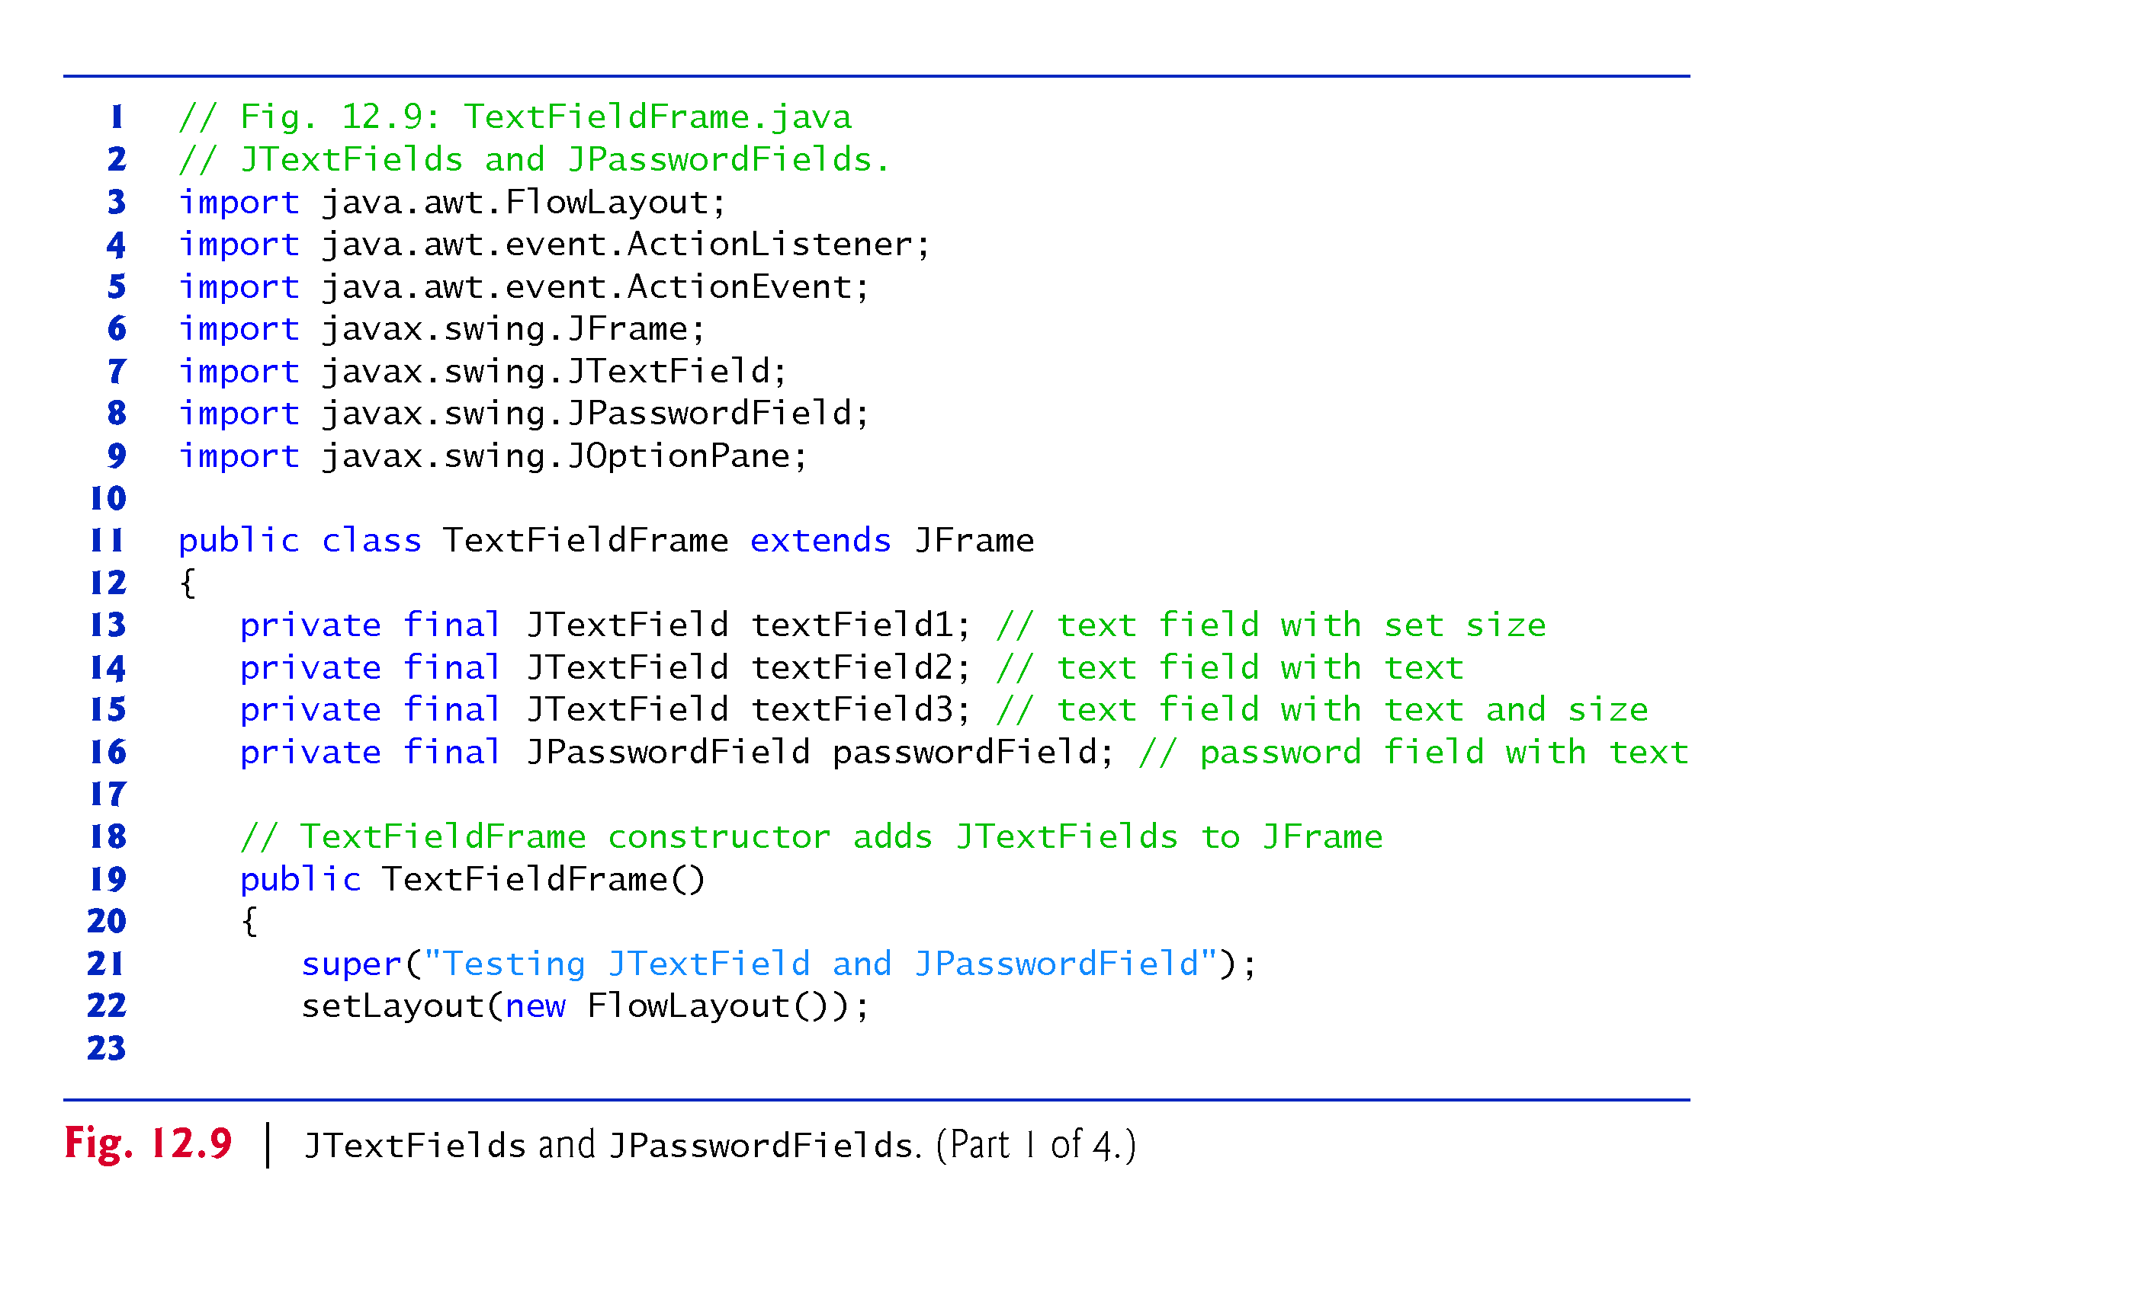

Slide 18
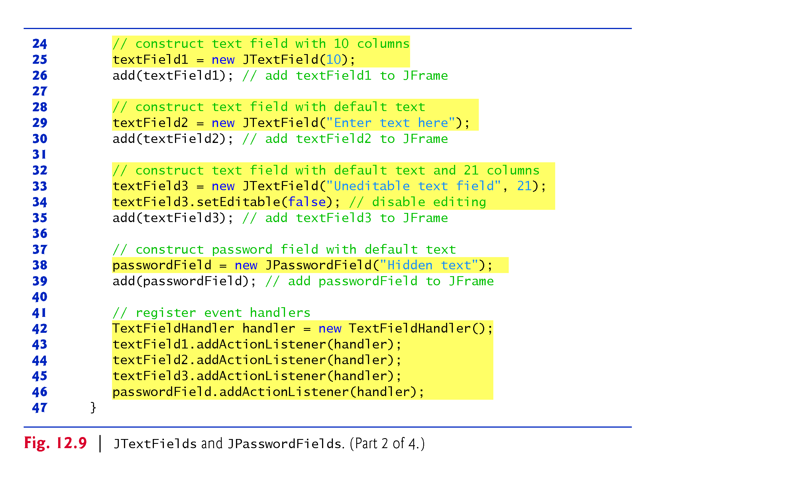

Slide 19
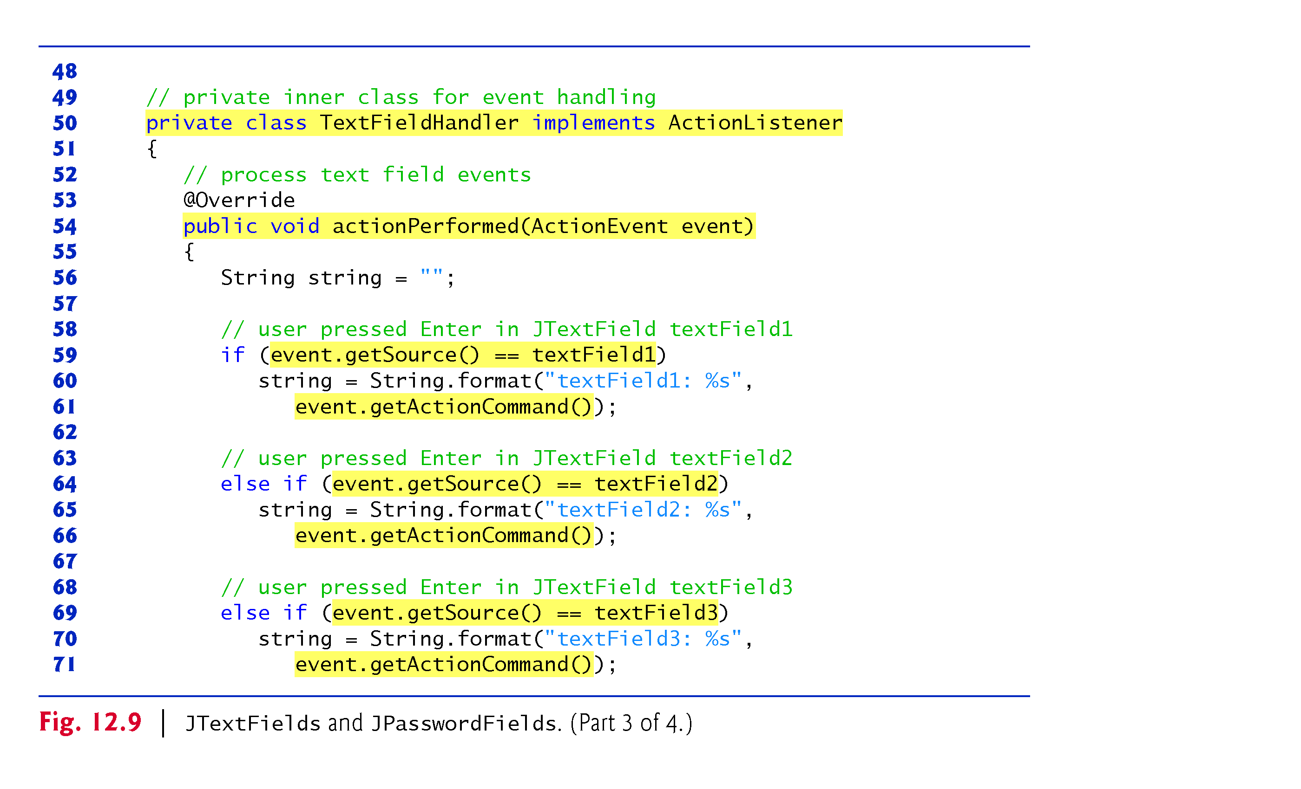

Slide 20
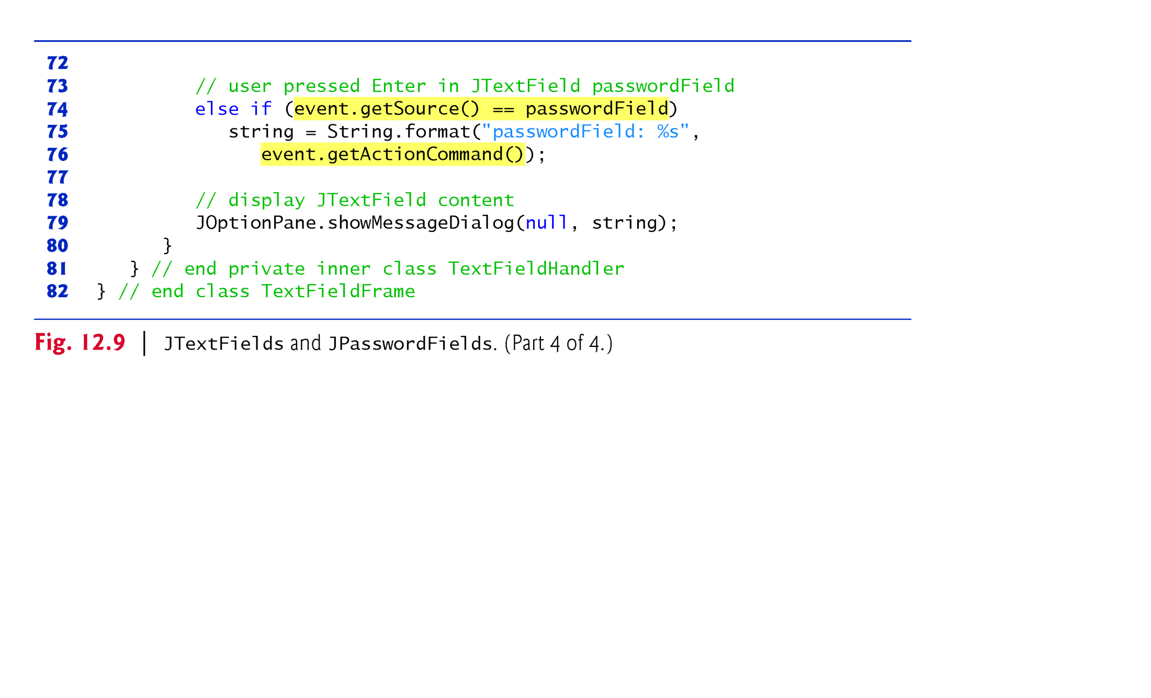

Slide 21
12.6 Text Fields and an Introduction to Event Handling with Nested Classes (cont.)
When the user types data into a JTextField or a JPasswordField, then presses Enter, an event occurs.
You can type only in the text field that is “in focus.”
A component receives the focus when the user clicks the component.

Slide 22
12.6 Text Fields and an Introduction to Event Handling with Nested Classes (cont.)
Before an application can respond to an event for a particular GUI component, you must perform several coding steps:
Create a class that represents the event handler.
Implement an appropriate interface, known as an event-listener interface, in the class from Step 1.
Indicate that an object of the class from Steps 1 and 2 should be notified when the event occurs. This is known as registering the event handler.

Slide 23
12.6 Text Fields and an Introduction to Event Handling with Nested Classes (cont.)
All the classes discussed so far were so-called top-level classes—that is, they were not declared inside another class.
Java allows you to declare classes inside other classes—these are called nested classes.
Can be static or non-static.
Non-static nested classes are called inner classes and are frequently used to implement event handlers.

Slide 24
12.6 Text Fields and an Introduction to Event Handling with Nested Classes (cont.)
Before an object of an inner class can be created, there must first be an object of the top-level class that contains the inner class.
This is required because an inner-class object implicitly has a reference to an object of its top-level class.
There is also a special relationship between these objects—the inner-class object is allowed to directly access all the variables and methods of the outer class.
A nested class that is static does not require an object of its top-level class and does not implicitly have a reference to an object of the top-level class.

Slide 25
12.6 Text Fields and an Introduction to Event Handling with Nested Classes (cont.)
Inner classes can be declared public, protected or private.
Since event handlers tend to be specific to the application in which they are defined, they are often implemented as private inner classes.

Slide 26
12.6 Text Fields and an Introduction to Event Handling with Nested Classes (cont.)
GUI components can generate many events in response to user interactions.
Each event is represented by a class and can be processed only by the appropriate type of event handler.
Normally, a component’s supported events are described in the Java API documentation for that component’s class and its superclasses.

Slide 27
12.6 Text Fields and an Introduction to Event Handling with Nested Classes (cont.)
Must register an object as the event handler for each text field.
addActionListener registers an ActionListener object to handle ActionEvents.
After an event handler is registered the object listens for events.

Slide 28
12.6 Text Fields and an Introduction to Event Handling with Nested Classes (cont.)
The component with which the user interacts is the event source.
ActionEvent method getSource (inherited from class EventObject) returns a reference to the event source.
ActionEvent method getActionCommand obtains the text the user typed in the text field that generated the event.
JPasswordField method getPassword returns the password’s characters as an array of type char.

Slide 29
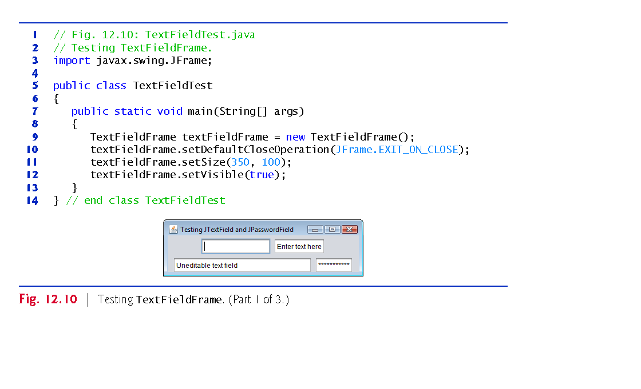

Slide 30
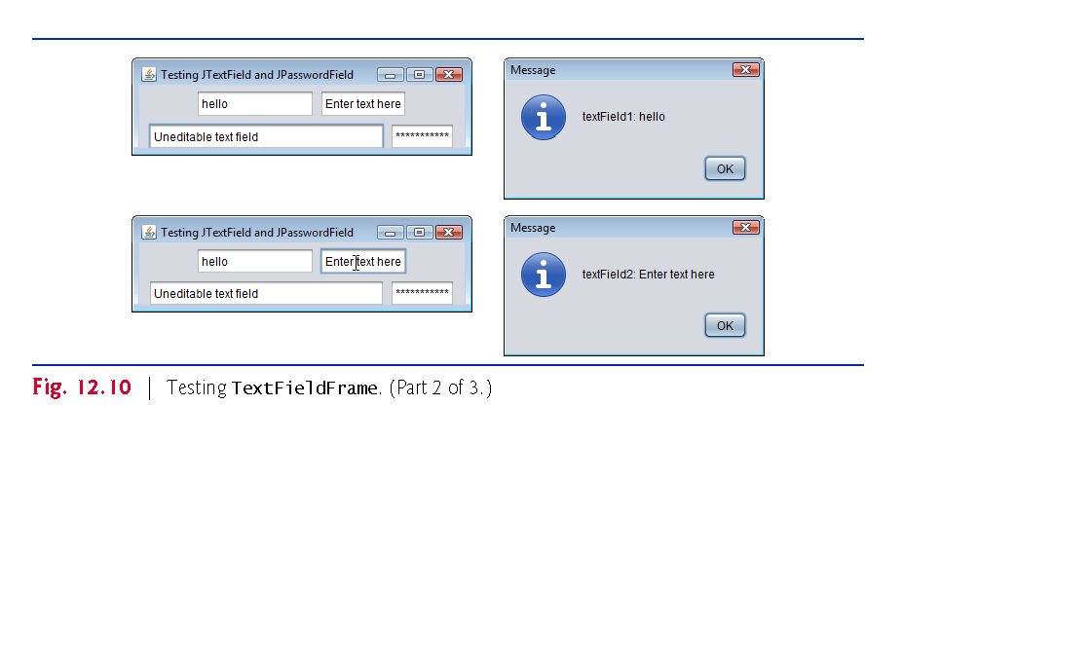

Slide 31
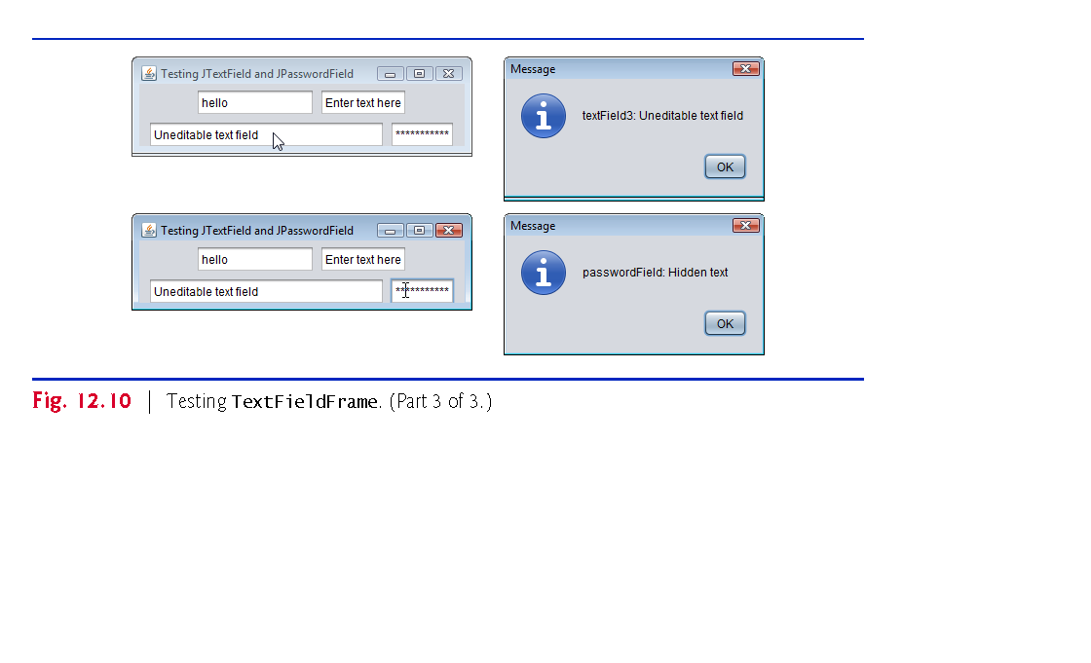

Slide 32
12.7 Common GUI Event Types and Listener Interfaces
Figure 12.11 illustrates a hierarchy containing many event classes from the package java.awt.event.
Used with both AWT and Swing components.
Additional event types that are specific to Swing GUI components are declared in package javax.swing.event.

Slide 33
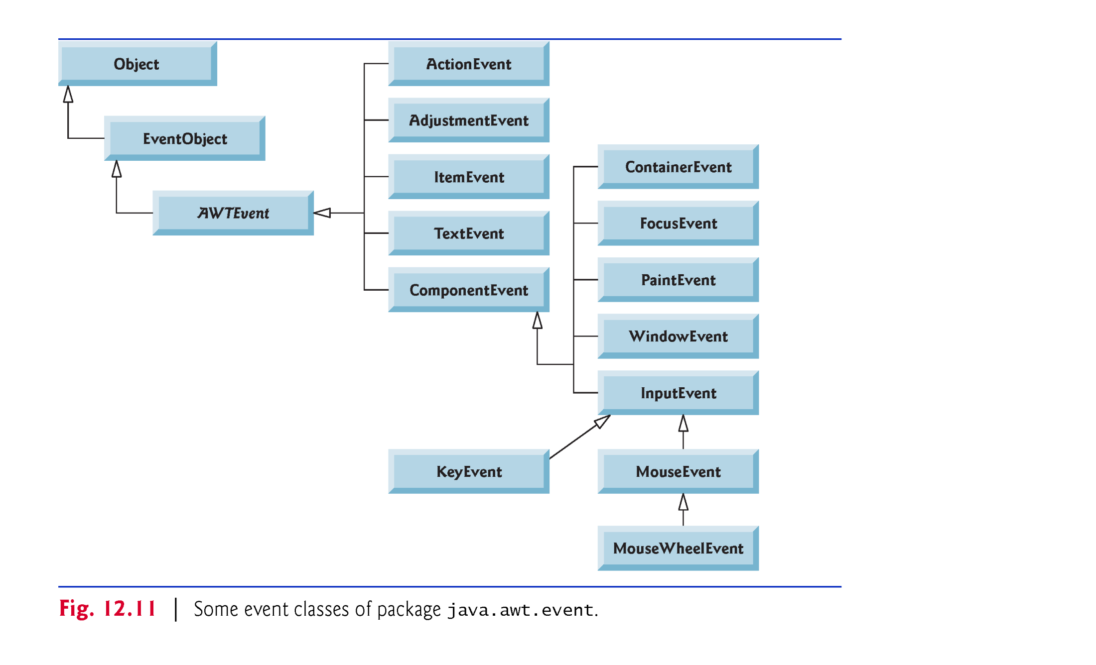

Slide 34
12.7 Common GUI Event Types and Listener Interfaces (cont.)
Delegation event model—an event’s processing is delegated to an object (the event listener) in the application.
For each event-object type, there is typically a corresponding event-listener interface.
Many event-listener types are common to both Swing and AWT components.
Such types are declared in package java.awt.event, and some of them are shown in Fig. 12.12.
Additional event-listener types that are specific to Swing components are declared in package javax.swing.event.

Slide 35
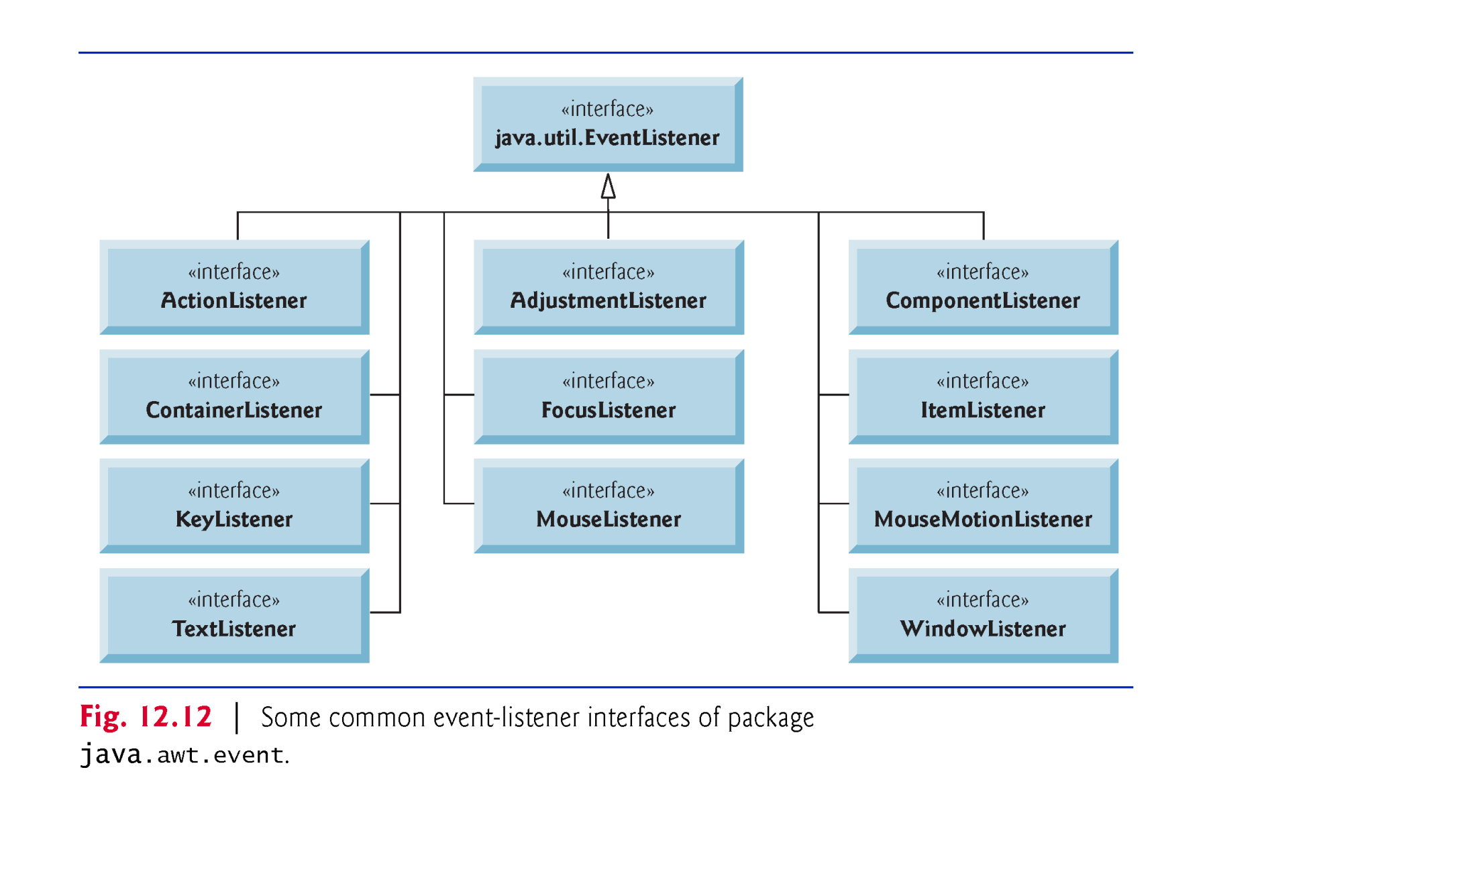

Slide 36
12.7 Common GUI Event Types and Listener Interfaces (cont.)
Each event-listener interface specifies one or more event-handling methods that must be declared in the class that implements the interface.
When an event occurs, the GUI component with which the user interacted notifies its registered listeners by calling each listener’s appropriate event-handling method.

Slide 37
12.8 How Event Handling Works
How the event-handling mechanism works:
Every JComponent has a variable listenerList that refers to an EventListenerList (package javax.swing.event).
Maintains references to registered listeners in the listenerList.
When a listener is registered, a new entry is placed in the component’s listenerList.
Every entry also includes the listener’s type.

Slide 38
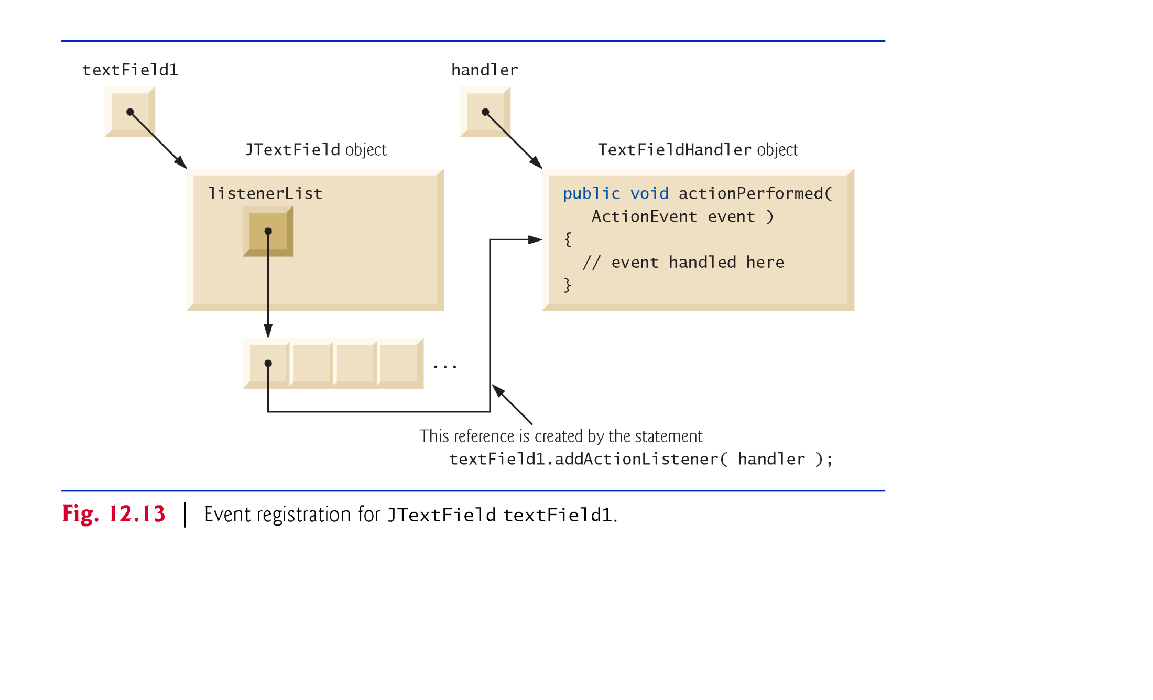

Slide 39
12.8 How Event Handling Works (cont.)
How does the GUI component know to call actionPerformed rather than another method?
Every GUI component supports several event types, including mouse events, key events and others.
When an event occurs, the event is dispatched only to the event listeners of the appropriate type.
Dispatching is simply the process by which the GUI component calls an event-handling method on each of its listeners that are registered for the event type that occurred.

Slide 40
12.8 How Event Handling Works (cont.)
Each event type has one or more corresponding event-listener interfaces.
ActionEvents are handled by ActionListeners
MouseEvents are handled by MouseListeners and MouseMotionListeners
KeyEvents are handled by KeyListeners
When an event occurs, the GUI component receives (from the JVM) a unique event ID specifying the event type.
The component uses the event ID to decide the listener type to which the event should be dispatched and to decide which method to call on each listener object.

Slide 41
12.8 How Event Handling Works (cont.)
For an ActionEvent, the event is dispatched to every registered ActionListener’s actionPerformed method.
For a Mouse-Event, the event is dispatched to every registered MouseListener or MouseMotionListener, depending on the mouse event that occurs.
The MouseEvent’s event ID determines which of the several mouse event-handling methods are called.

Slide 42
12.9 JButton
A button is a component the user clicks to trigger a specific action.
Several types of buttons
command buttons
checkboxes
toggle buttons
radio buttons
Button types are subclasses of AbstractButton (package javax.swing), which declares the common features of Swing buttons.

Slide 43
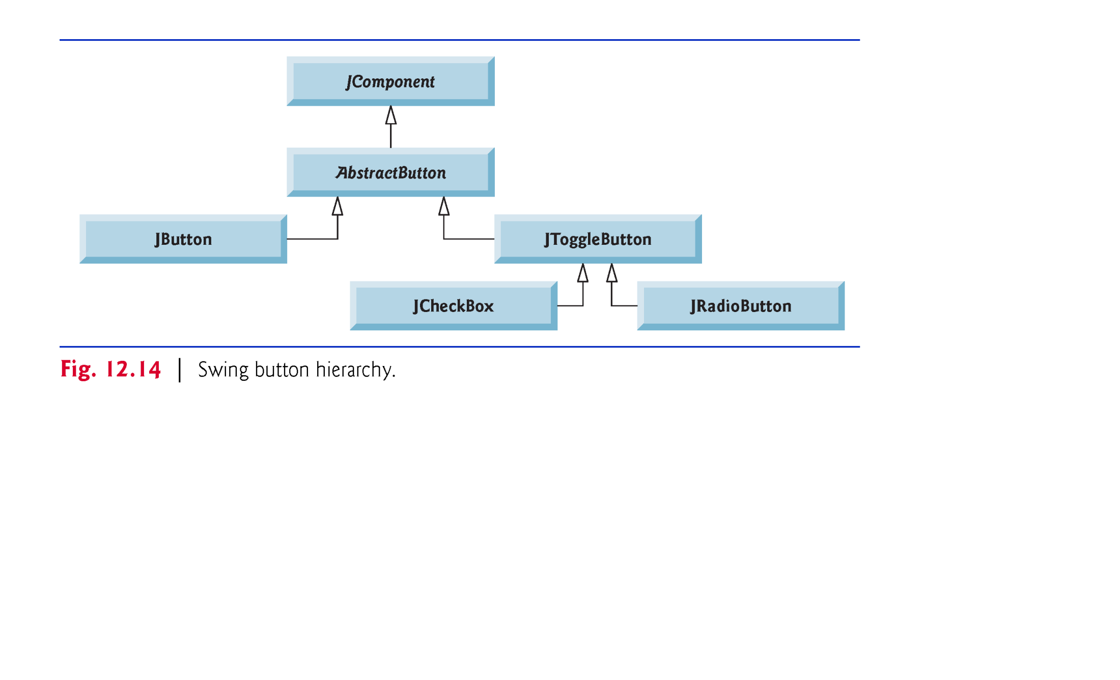

Slide 44
12.9 JButton (cont.)
A command button generates an ActionEvent when the user clicks it.
Command buttons are created with class JButton.
The text on the face of a JButton is called a button label.

Slide 45
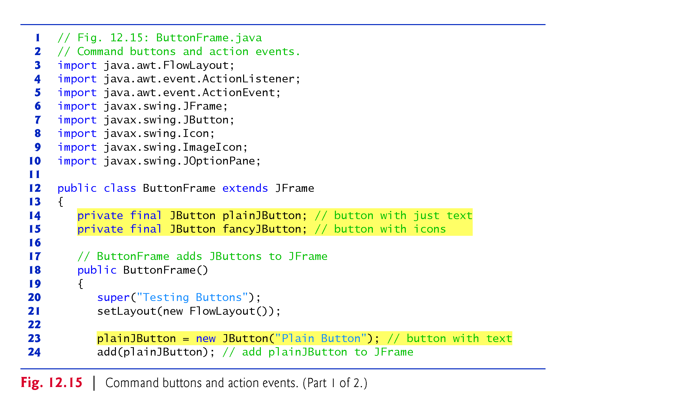

Slide 46
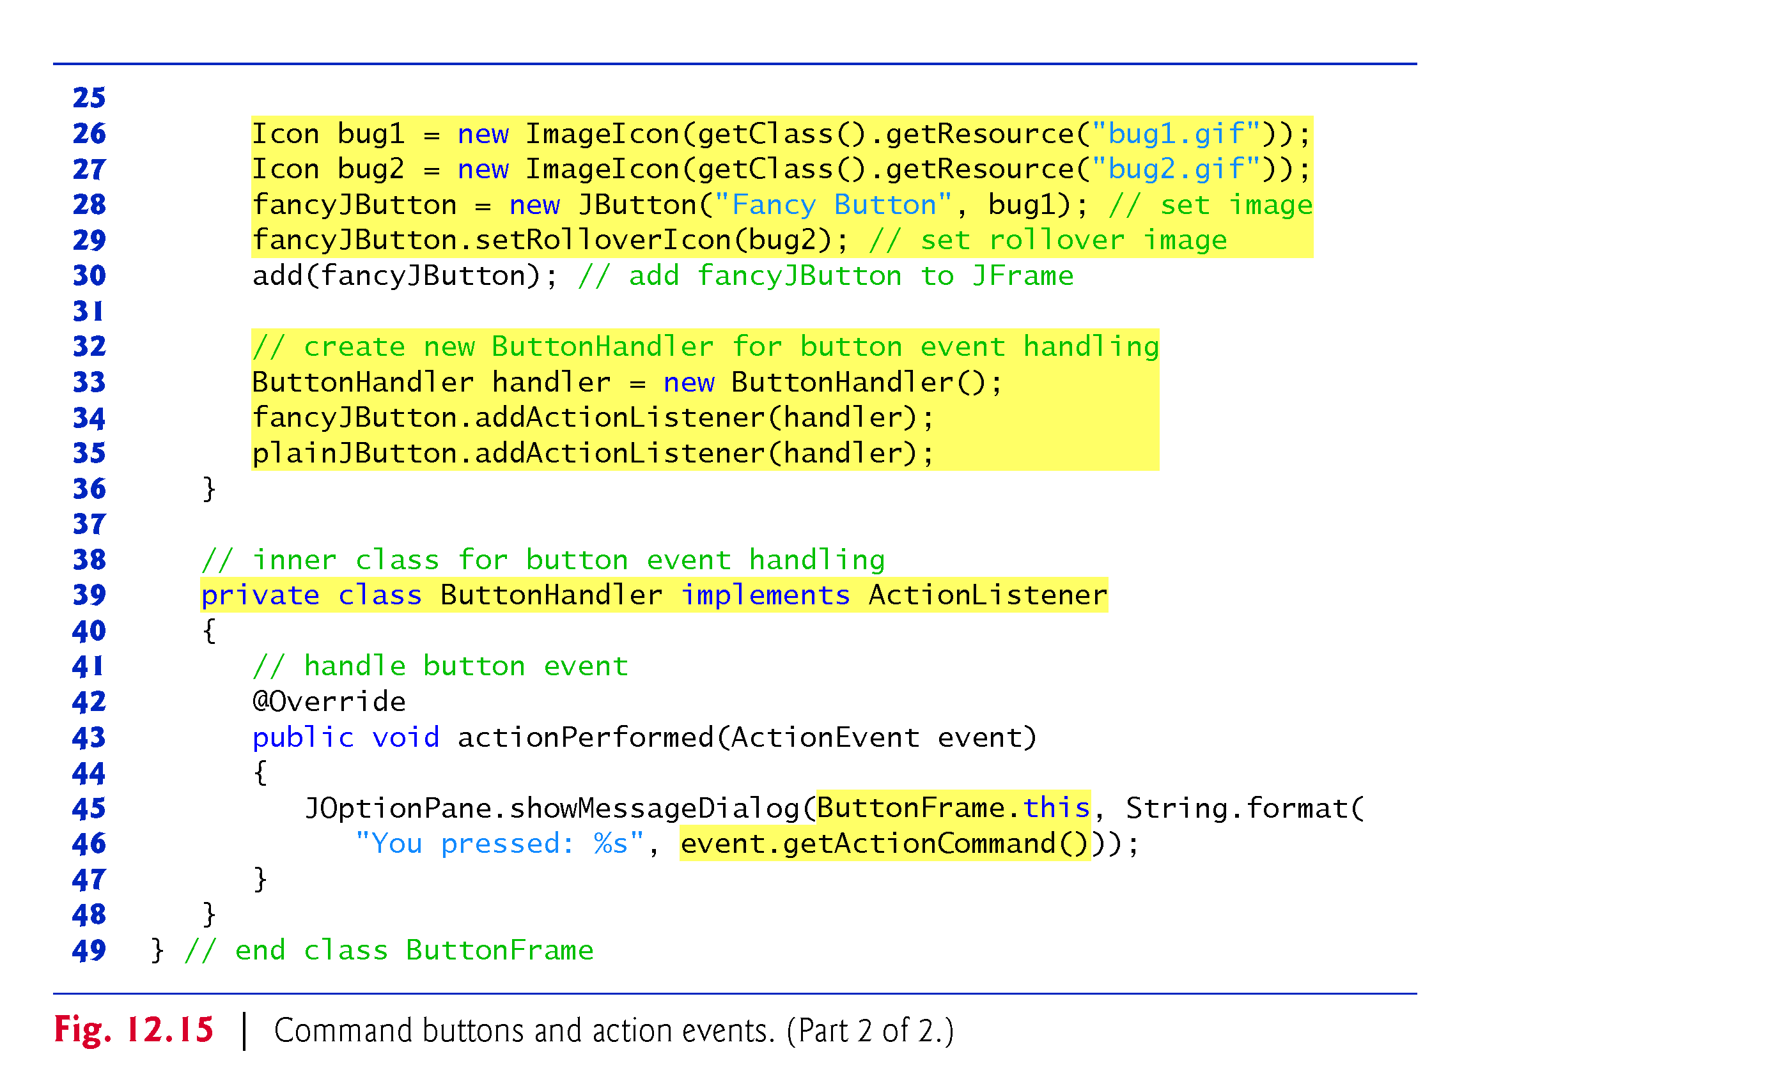

Slide 47
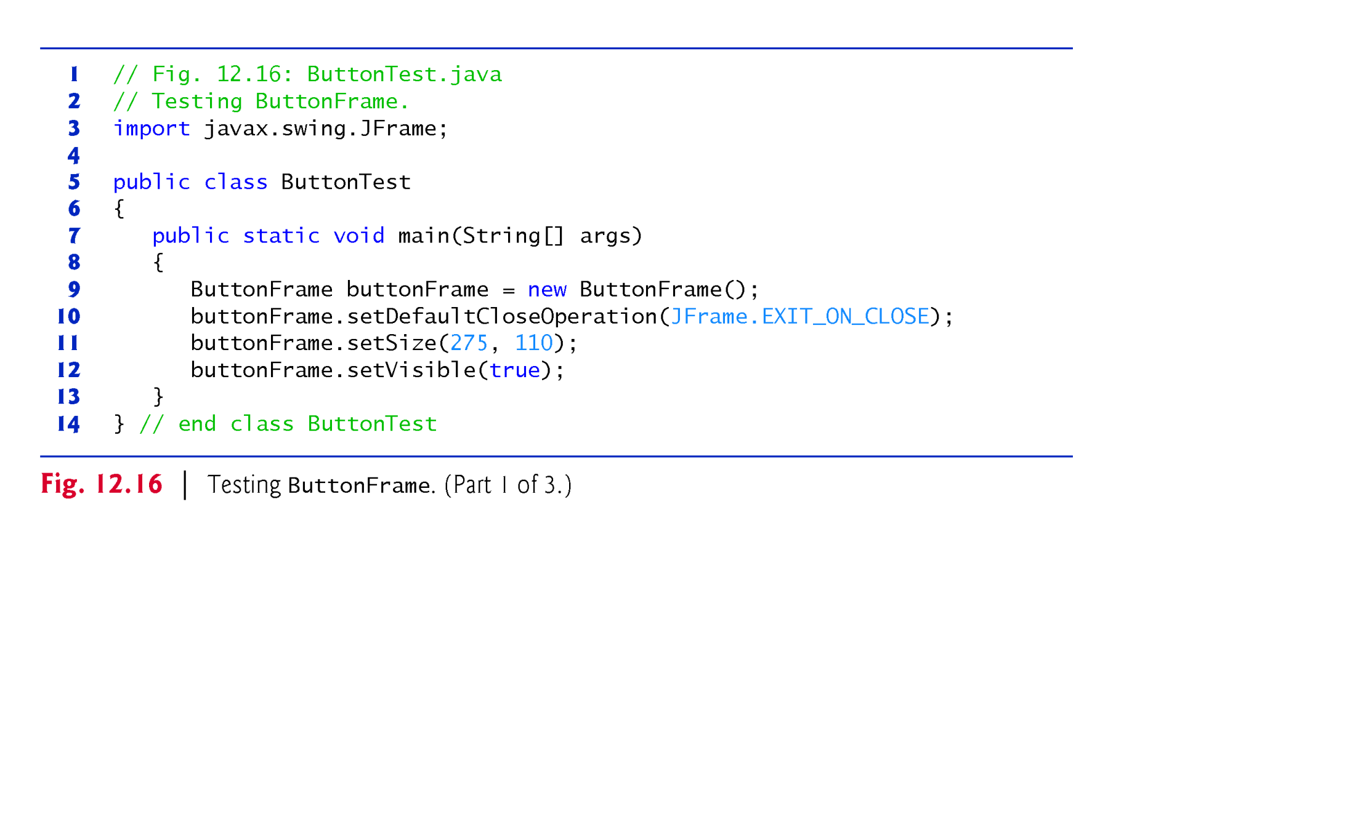

Slide 48
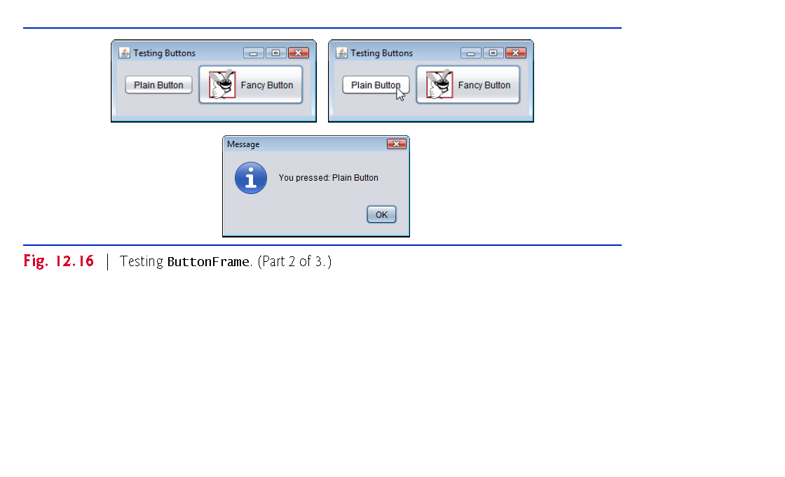

Slide 49
12.10 Buttons That Maintain State
Three types of state buttons—JToggleButton, JCheckBox and JRadioButton—that have on/off or true/false values.
Classes JCheckBox and JRadioButton are subclasses of JToggleButton.
JRadioButtons are grouped together and are mutually exclusive—only one in the group can be selected at any time

Slide 50
12.10.1 JCheckBox
JTextField method setFont (inherited by JTextField indirectly from class Component) sets the font of the JTextField to a new Font (package java.awt).
String passed to the JCheckBox constructor is the checkbox label that appears to the right of the JCheckBox by default.
When the user clicks a JCheckBox, an ItemEvent occurs.
Handled by an ItemListener object, which must implement method itemStateChanged.
An ItemListener is registered with method addItemListener.
JCheckBox method isSelected returns true if a JCheckBox is selected.

Slide 51
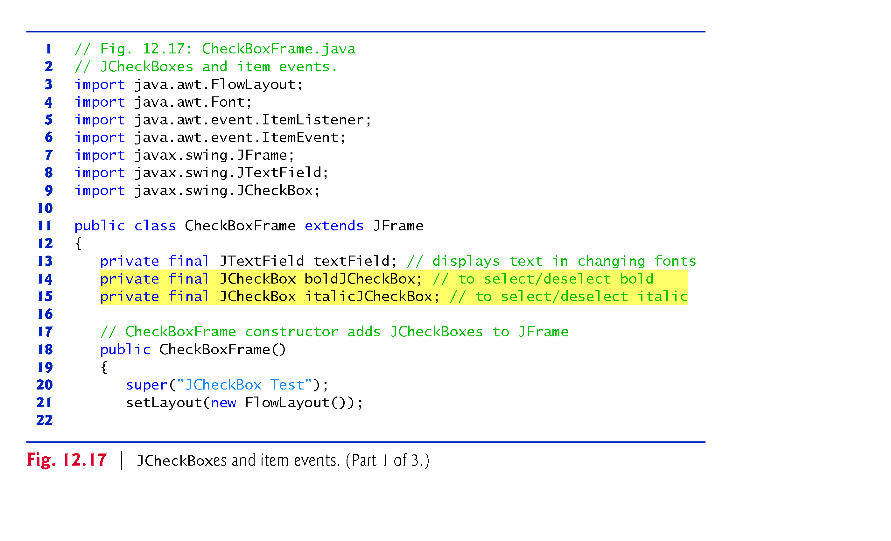

Slide 52
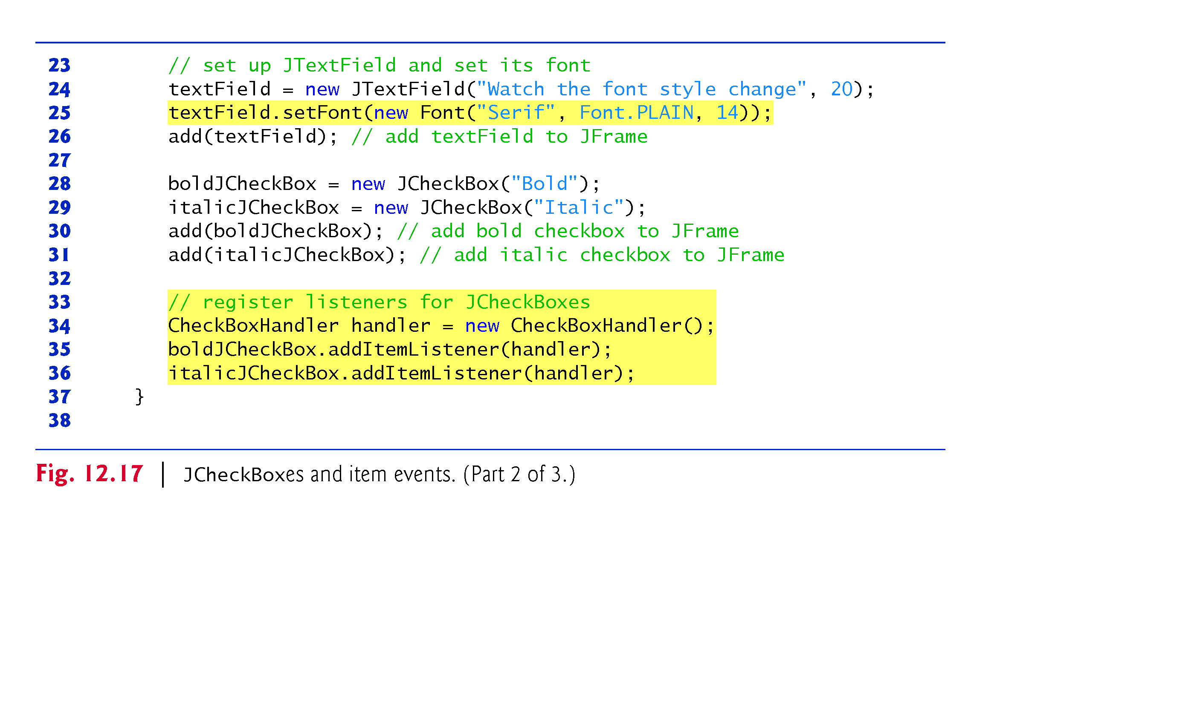

Slide 53
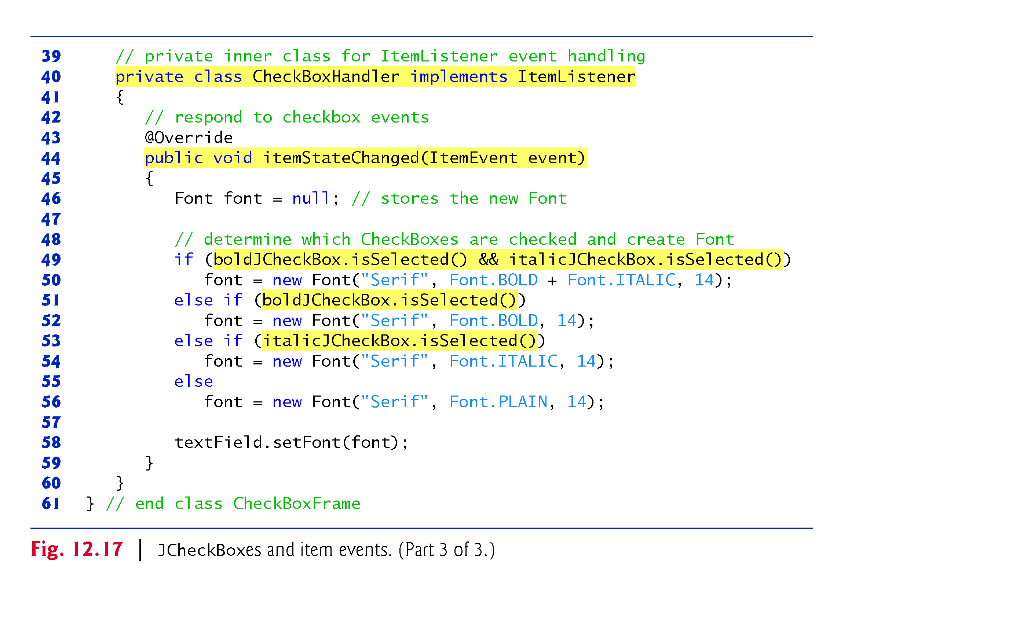

Slide 54
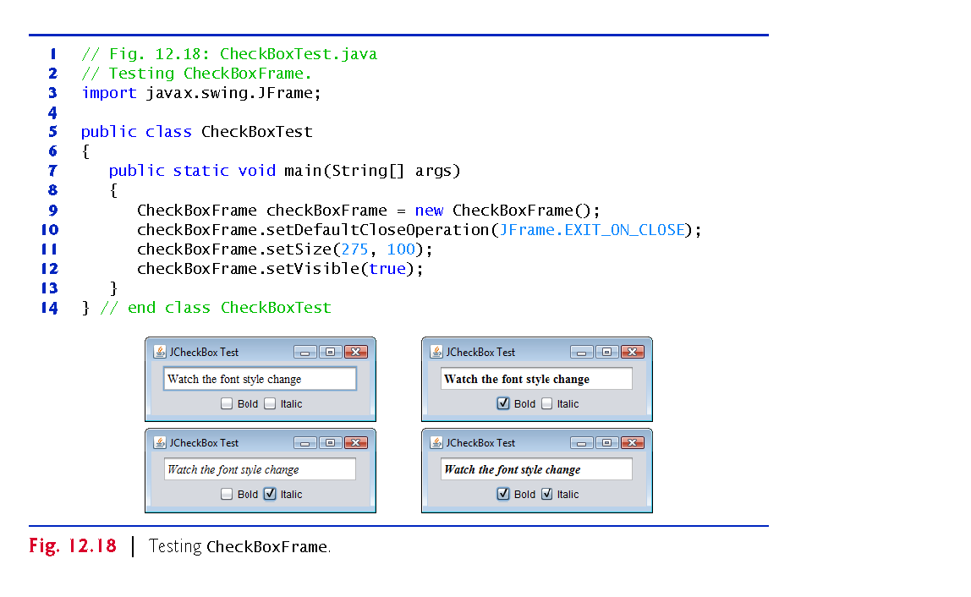

Slide 55
12.10.2 JRadioButton
Radio buttons (declared with class JRadioButton) are similar to checkboxes in that they have two states—selected and not selected (also called deselected).
Radio buttons normally appear as a group in which only one button can be selected at a time.
Used to represent mutually exclusive options.
The logical relationship between radio buttons is maintained by a ButtonGroup object (package javax.swing), which organizes a group of buttons and is not itself displayed in a user interface.

Slide 56
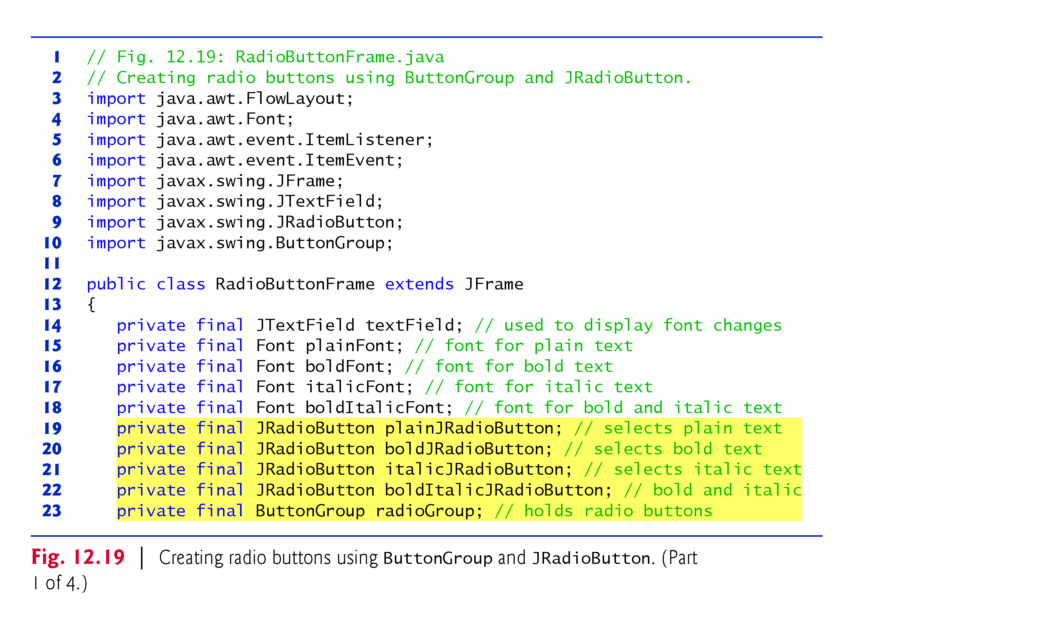

Slide 57
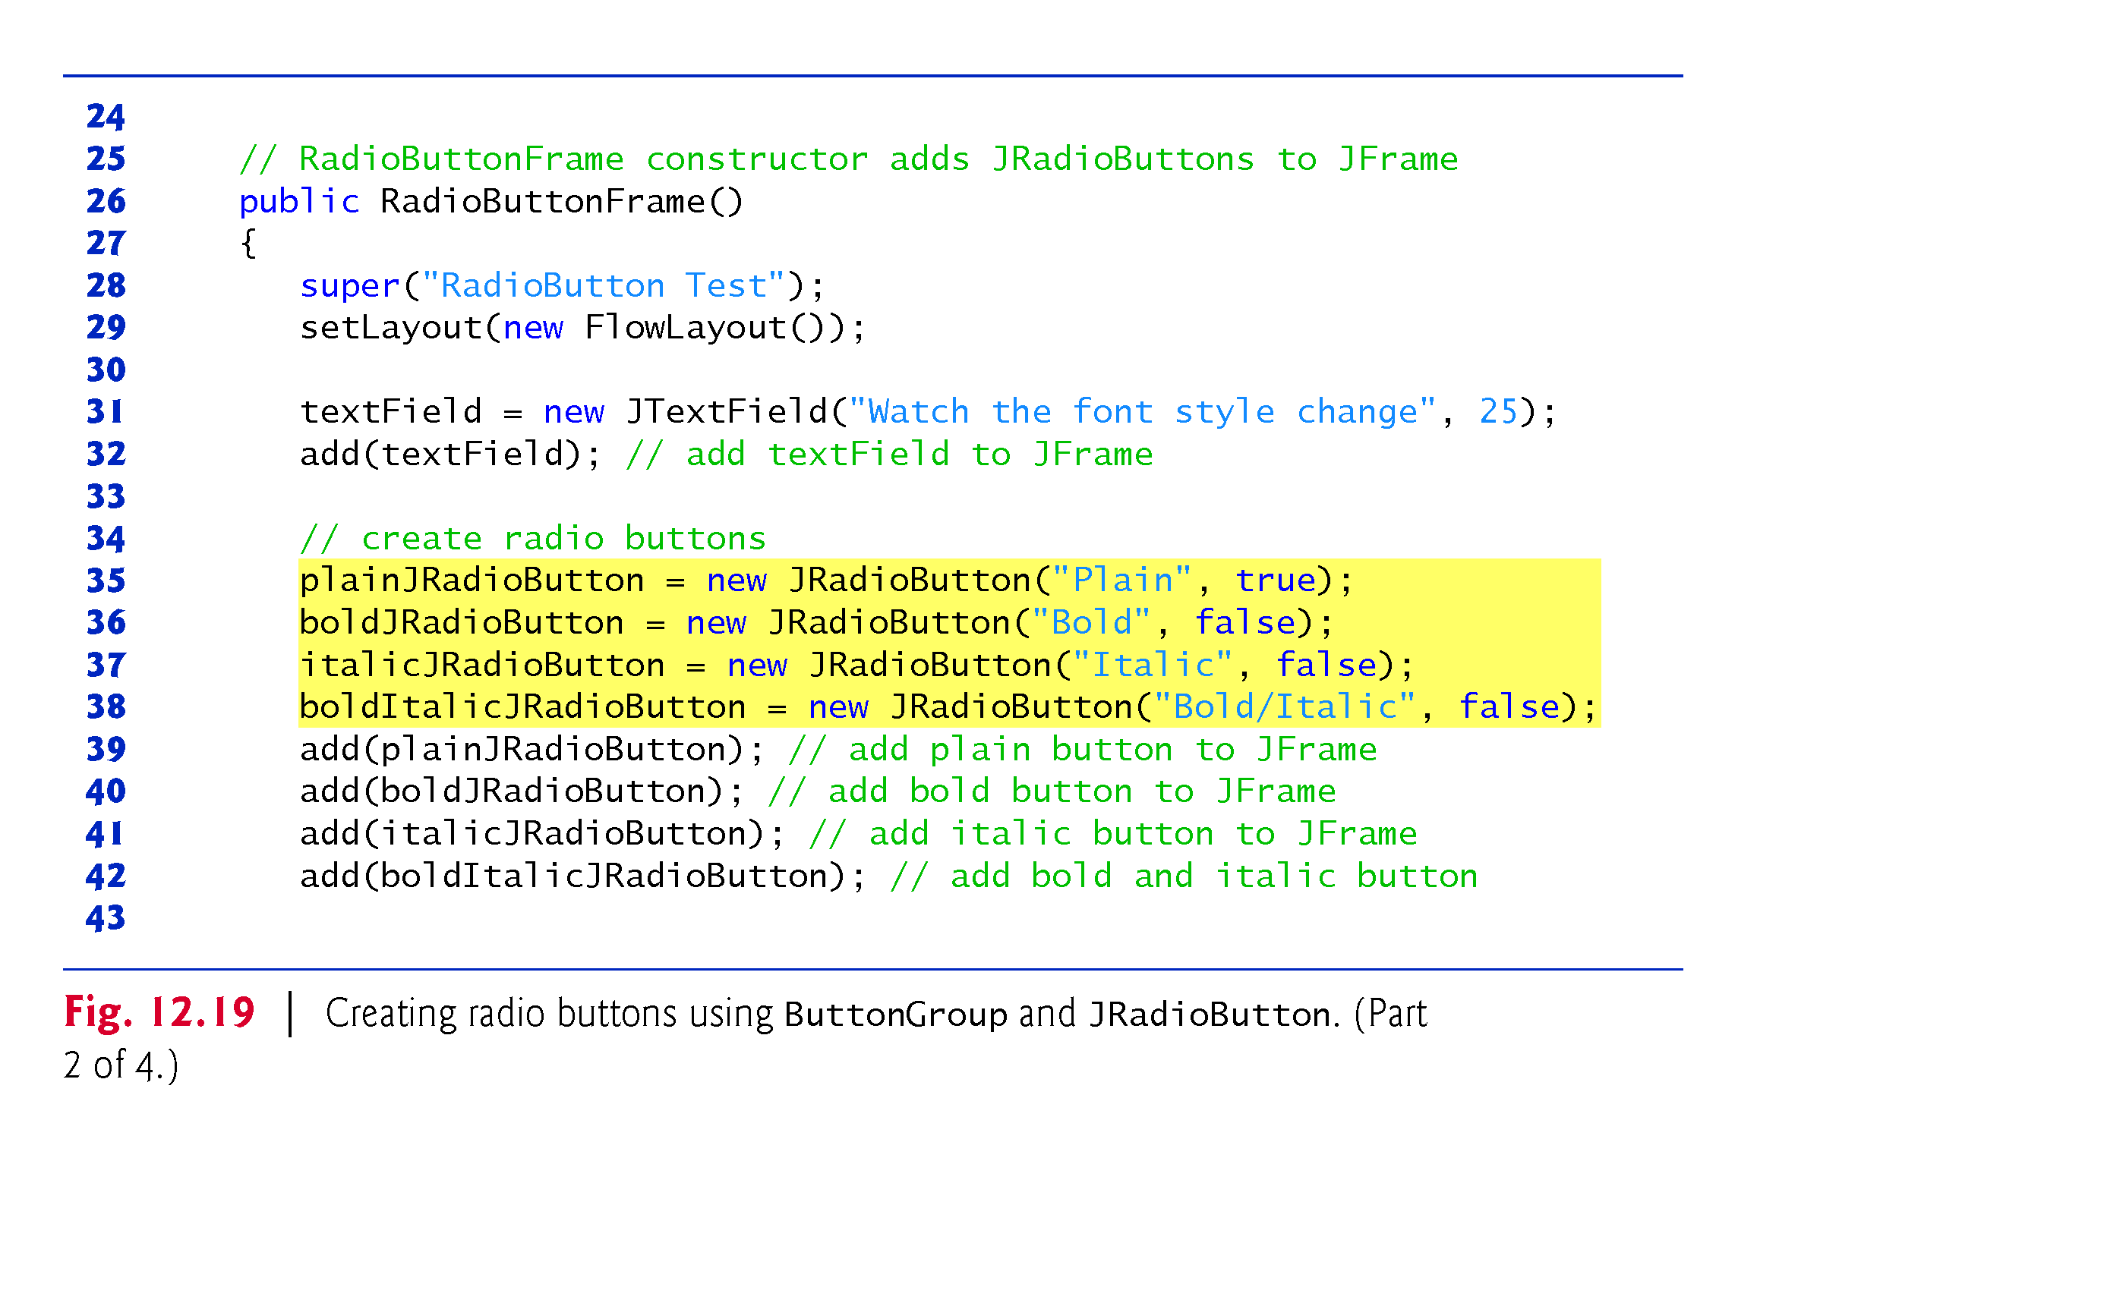

Slide 58
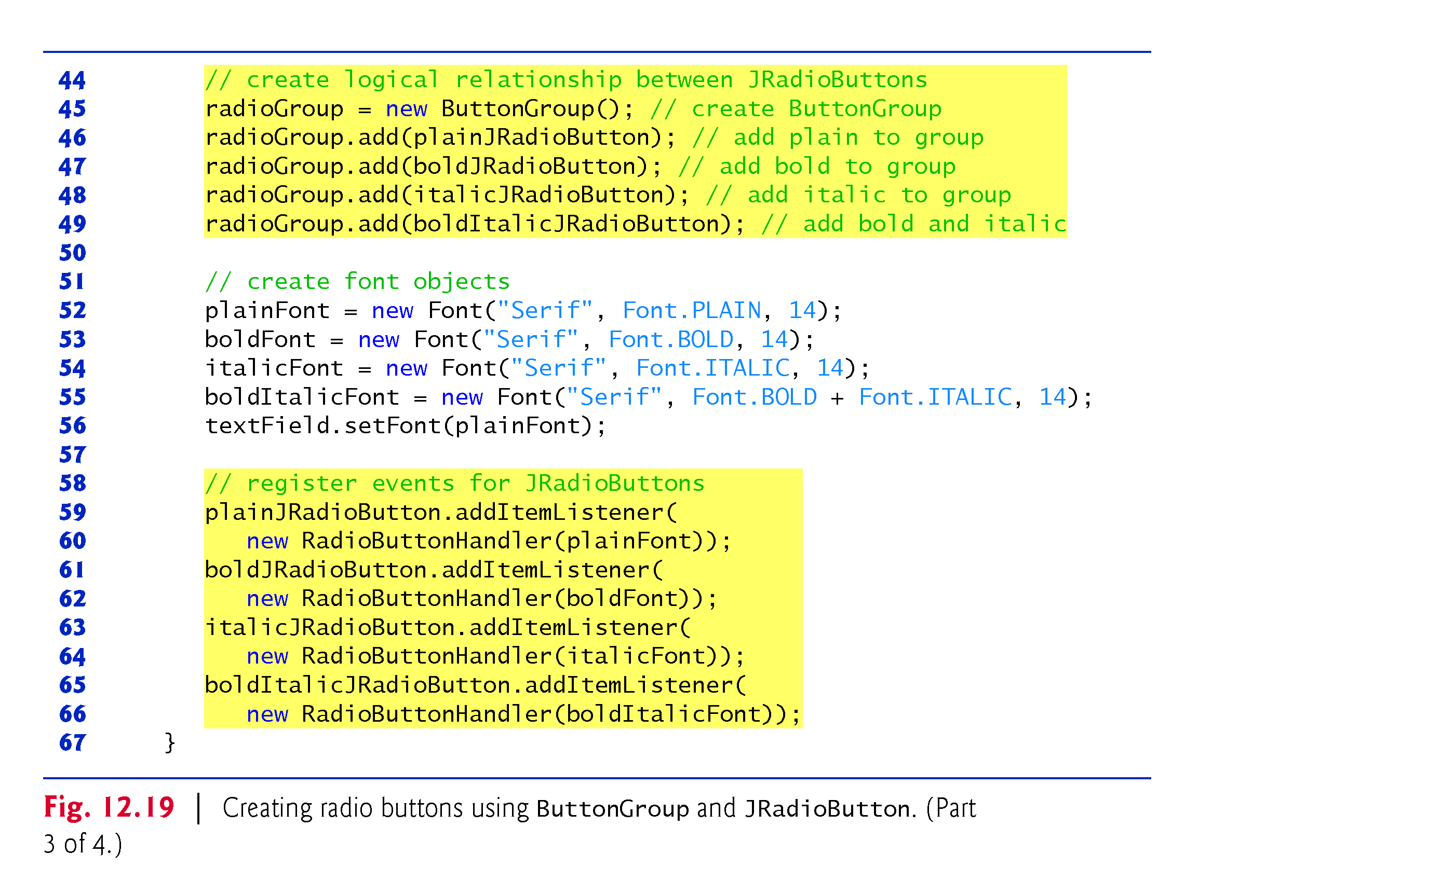

Slide 59
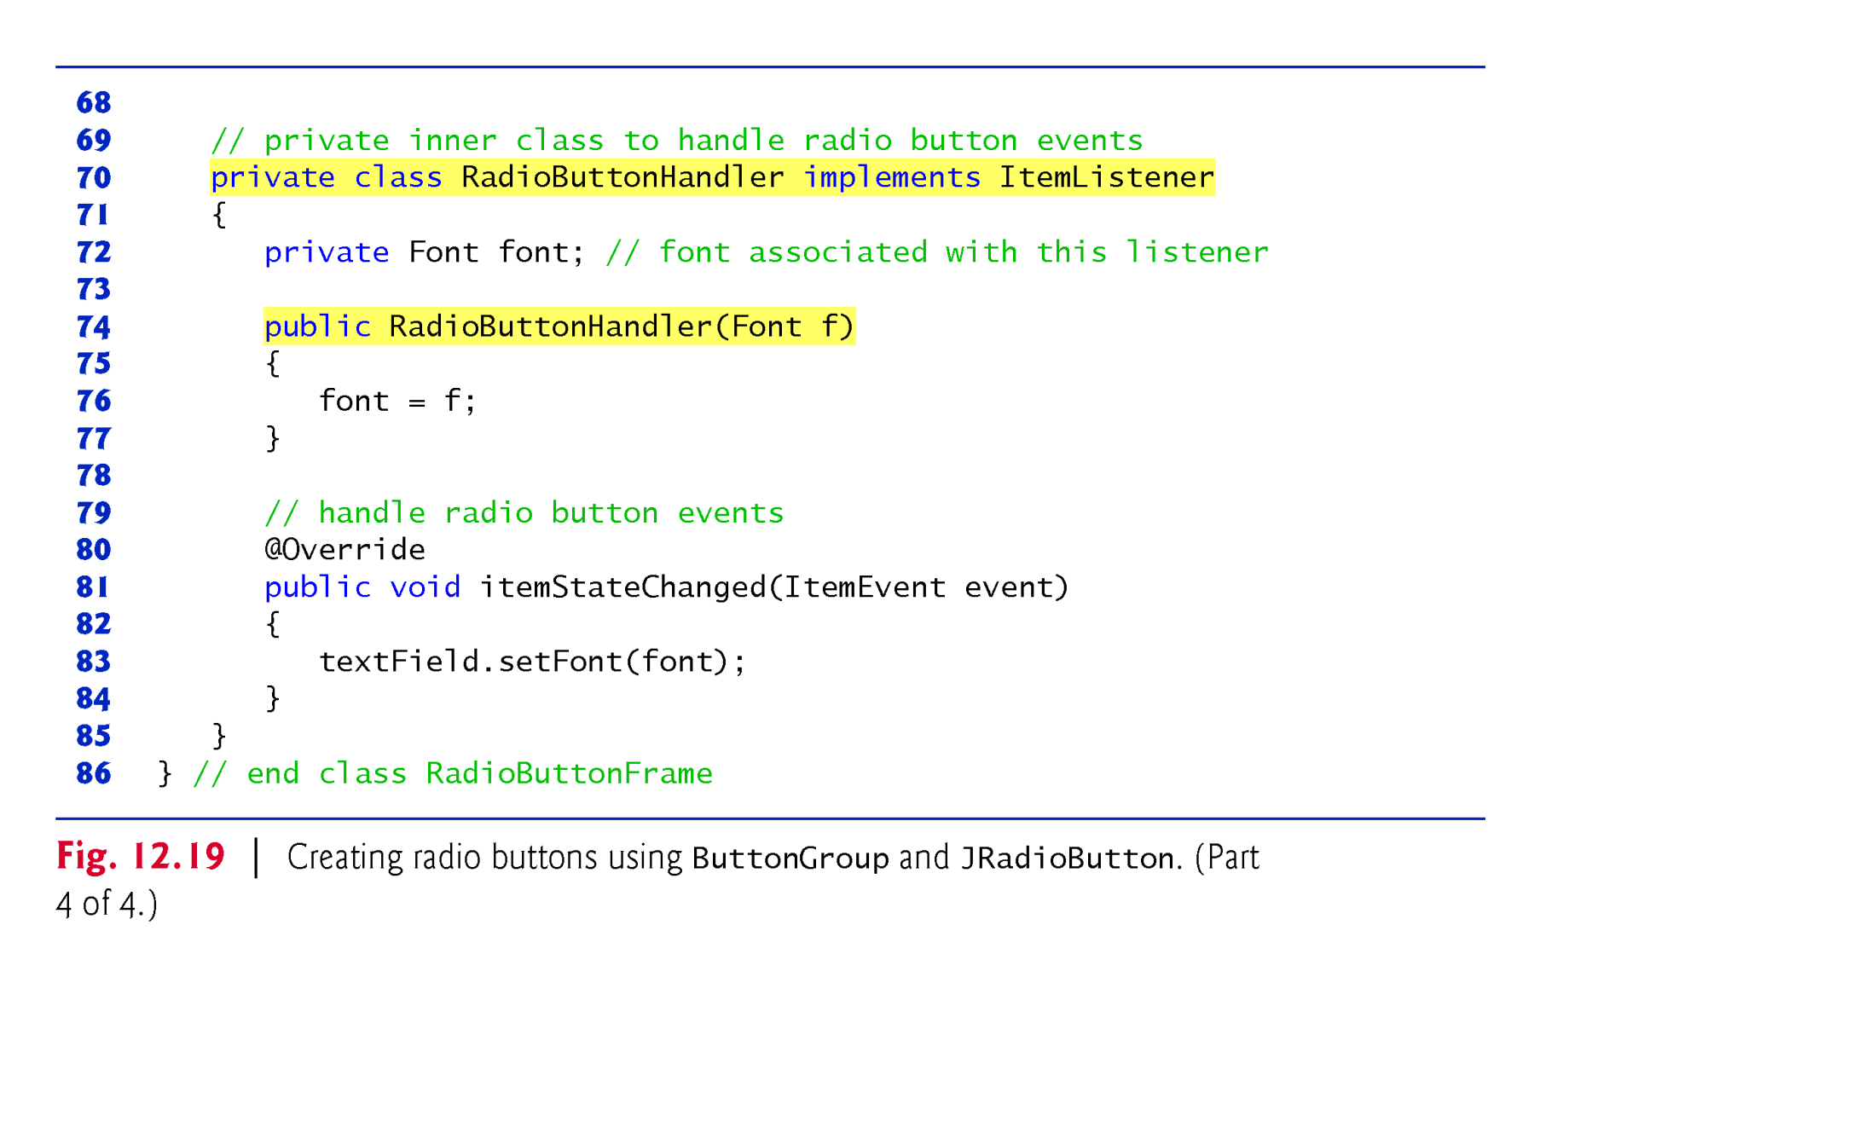

Slide 60
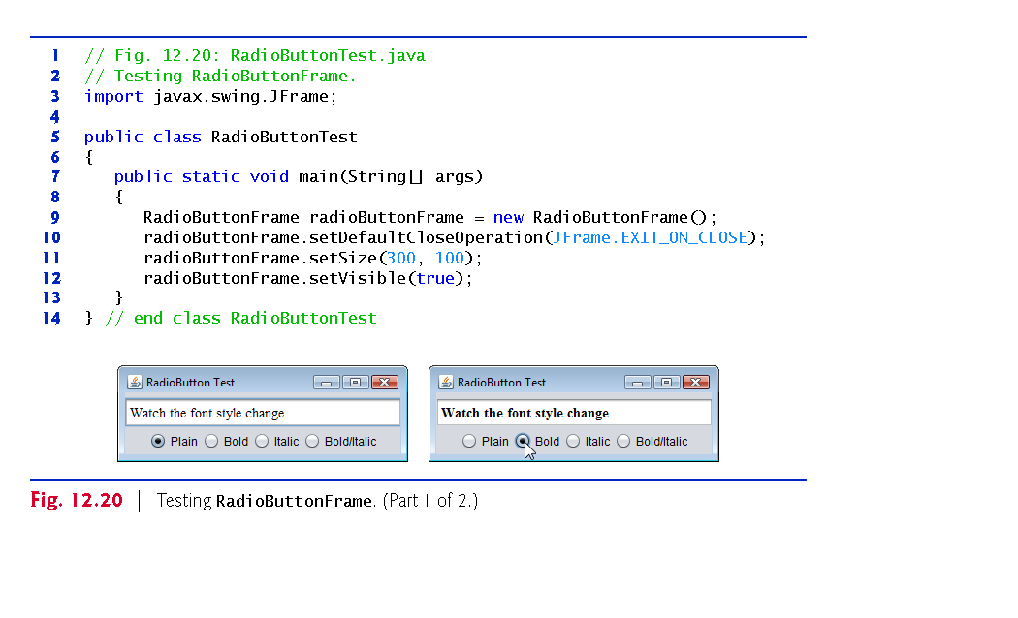

Slide 61
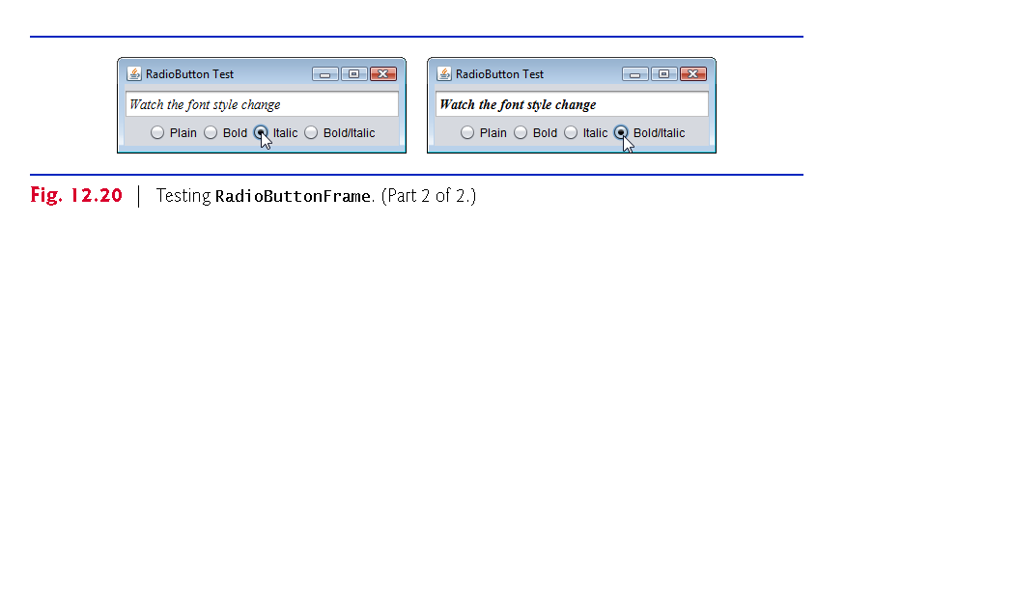

Slide 62
12.11 JComboBox; Using an Anonymous Inner Class for Event Handling
A combo box (sometimes called a drop-down list) enables the user to select one item from a list.
Combo boxes are implemented with class JComboBox, which extends class JComponent.
JComboBoxes generate ItemEvents.

Slide 63
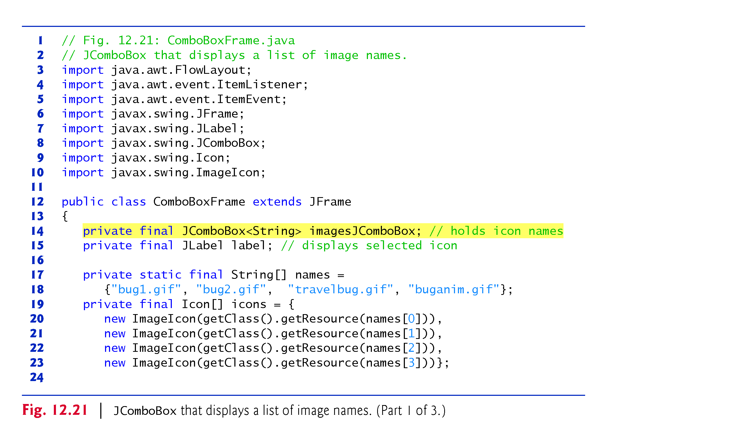

Slide 64
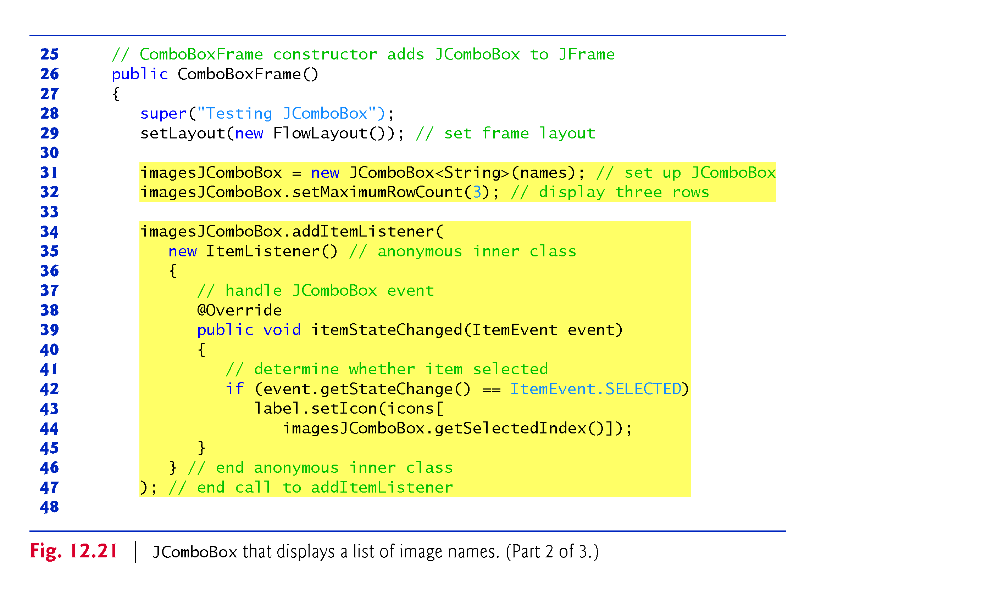

Slide 65
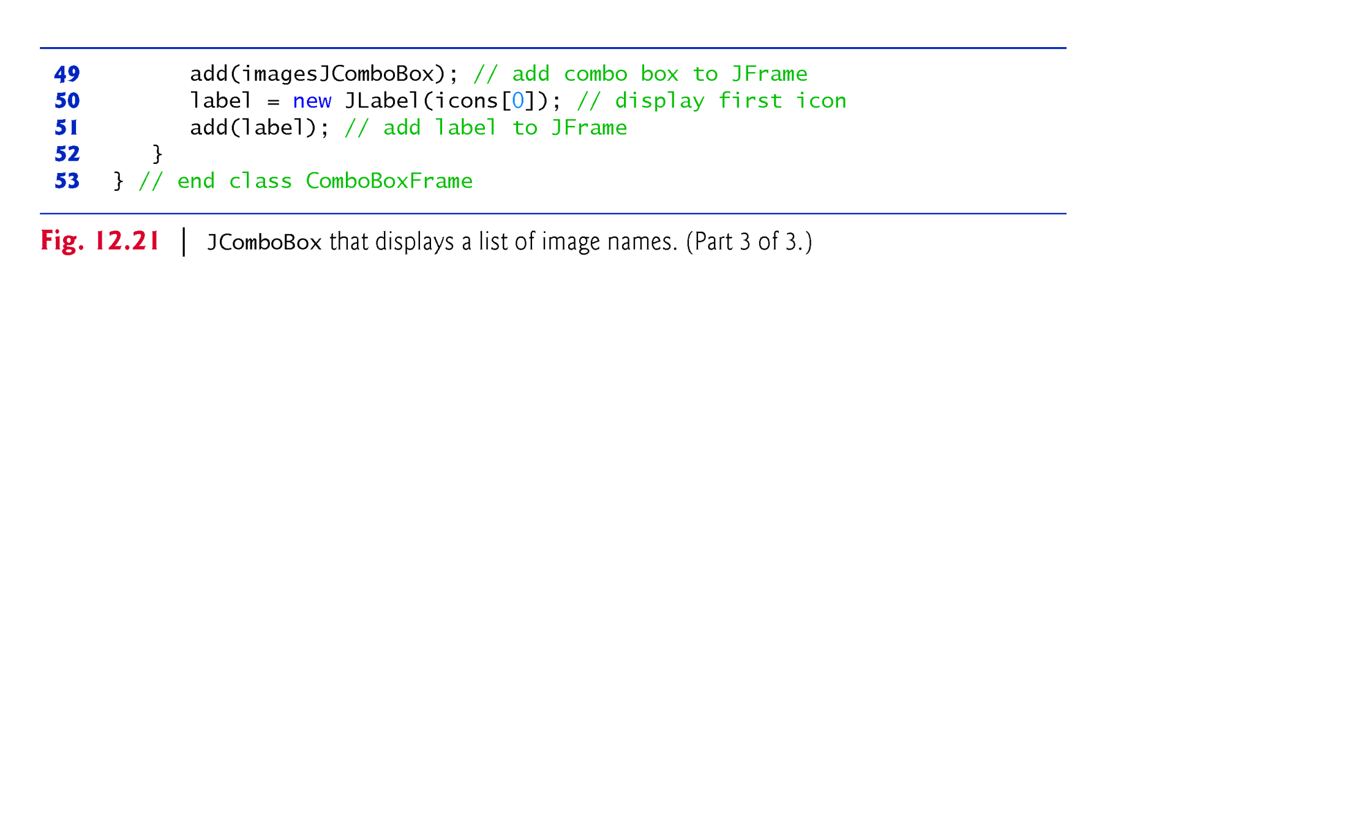

Slide 66
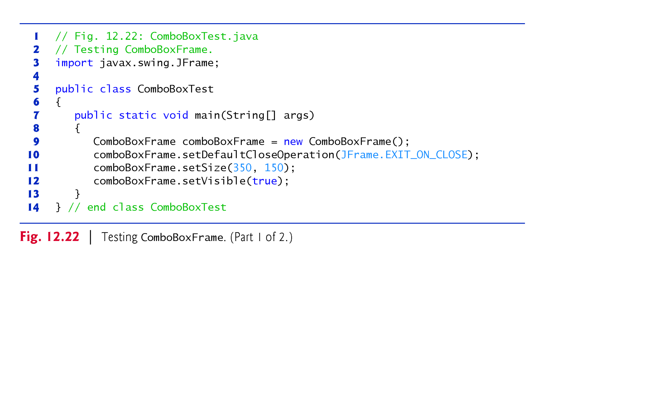

Slide 67
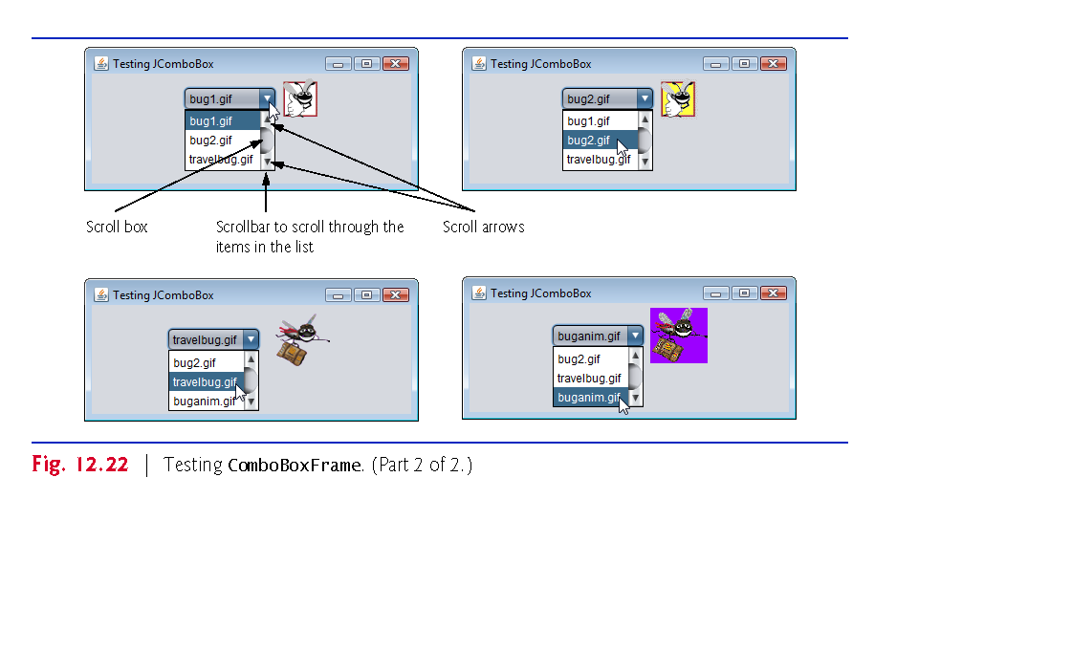

Slide 68
12.12 JList
A list displays a series of items from which the user may select one or more items.
Lists are created with class JList, which directly extends class JComponent.
Class JList—which like JComboBox is a generic class—supports single-selection lists (only one item to be selected at a time) and multiple-selection lists (any number of items to be selected).
JLists generate ListSelectionEvents in single-selection lists.

Slide 69
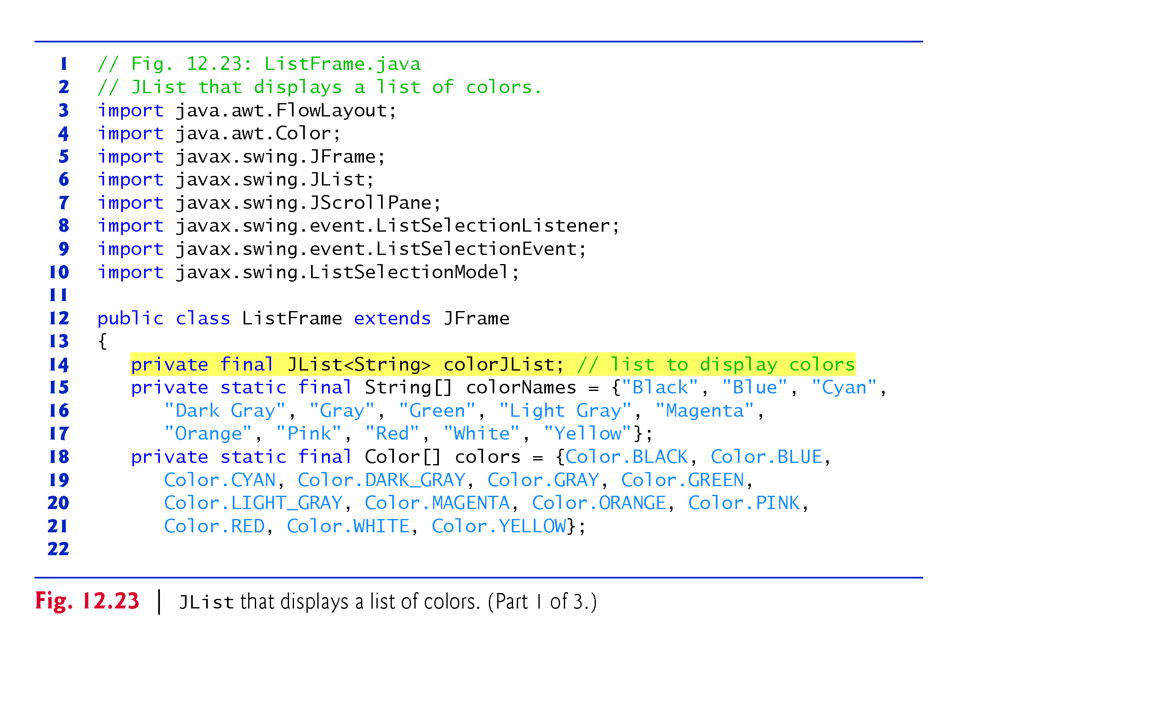

Slide 70
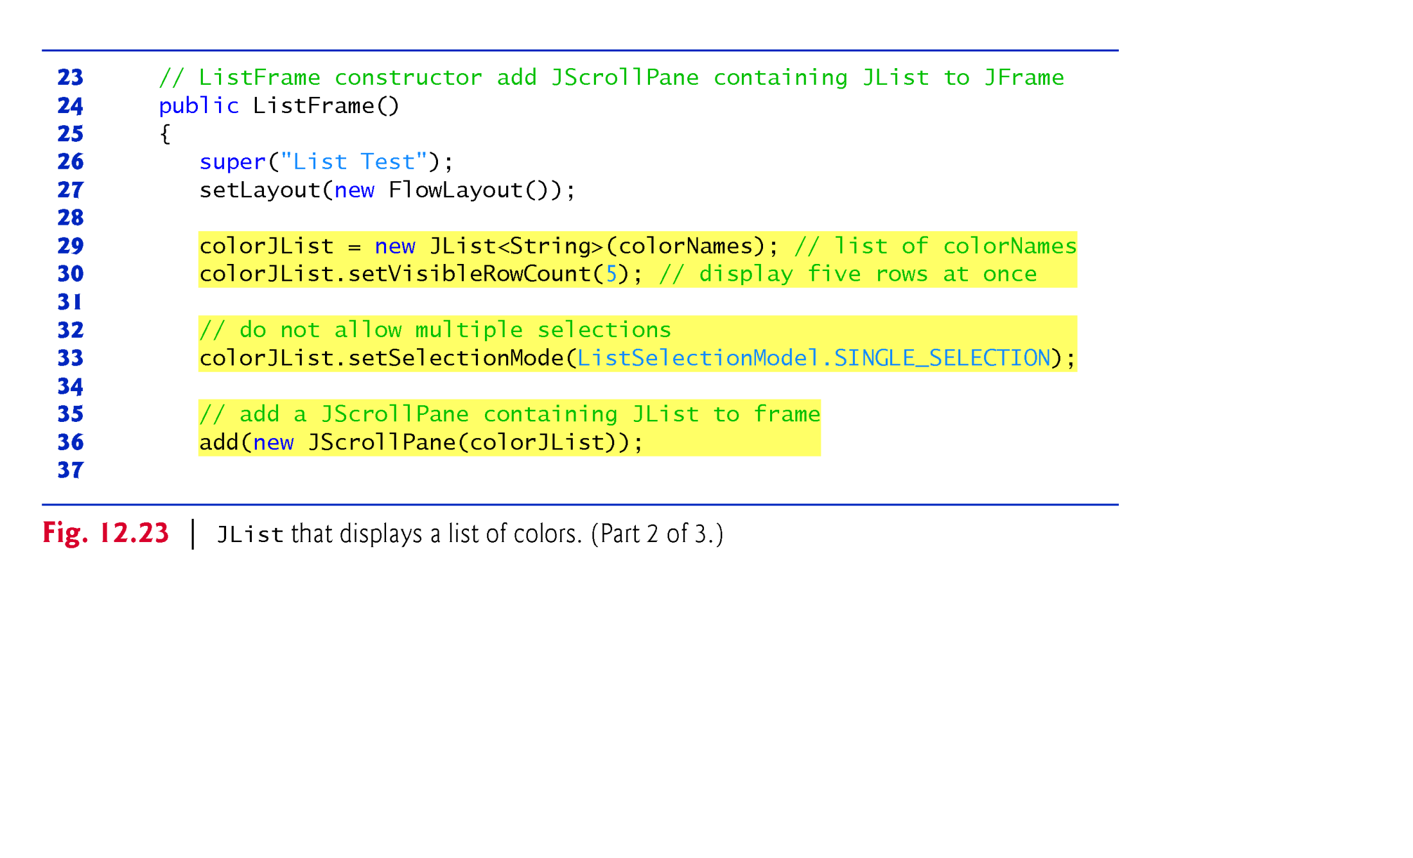

Slide 71
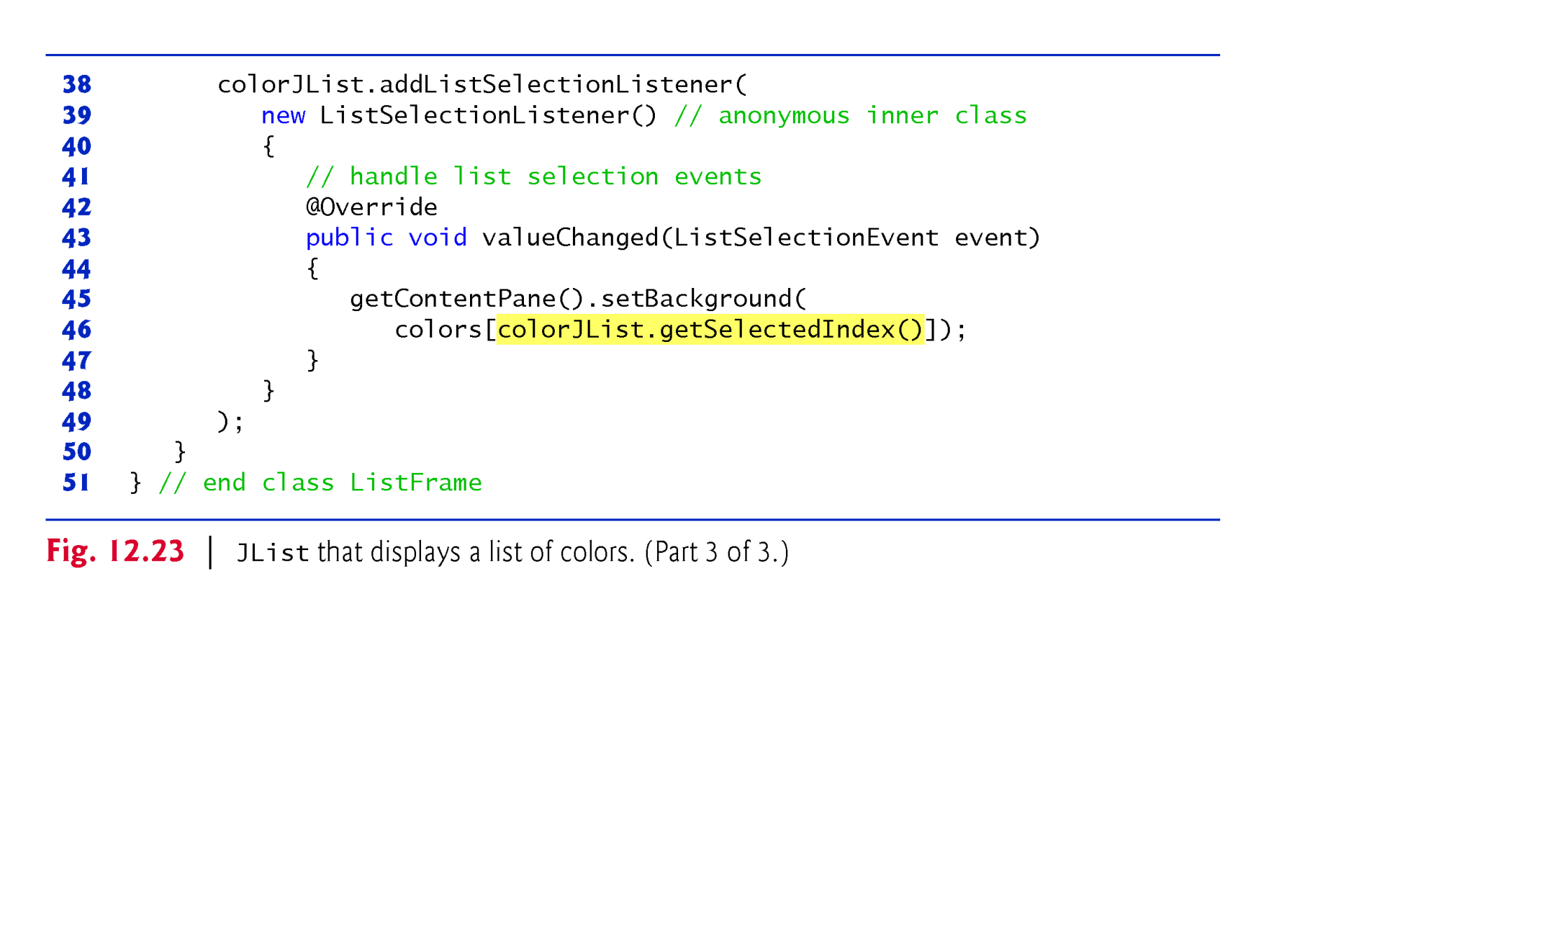

Slide 72
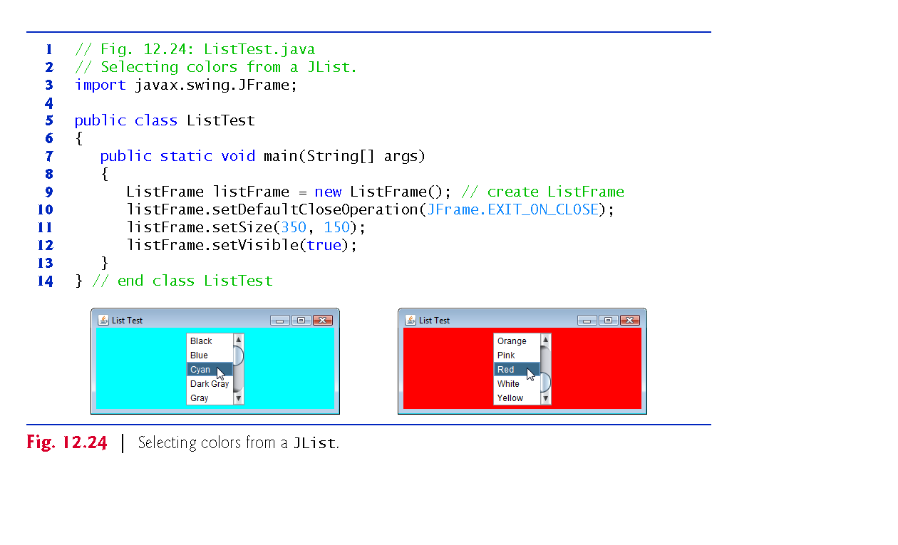

Slide 73
12.12 JList (cont.)
setVisibleRowCount specifies the number of items visible in the list.
setSelectionMode specifies the list’s selection mode.
Class ListSelectionModel (of package javax.swing) declares selection-mode constants
SINGLE_SELECTION (only one item to be selected at a time)
SINGLE_INTERVAL_SELECTION (allows selection of several contiguous items)
MULTIPLE_INTERVAL_SELECTION (does not restrict the items that can be selected).

Slide 74
12.14 Mouse Event Handling
MouseListener and MouseMotionListener event-listener interfaces for handling mouse events.
Any GUI component
Package javax.swing.event contains interface MouseInputListener, which extends interfaces MouseListener and MouseMotionListener to create a single interface containing all the methods.
MouseListener and MouseMotionListener methods are called when the mouse interacts with a Component if appropriate event-listener objects are registered for that Component.

Slide 75
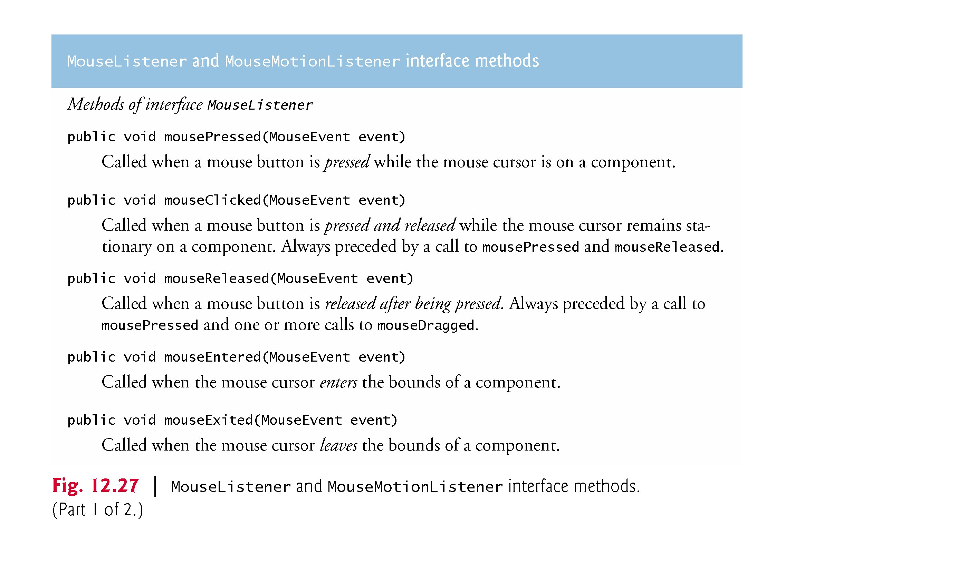

Slide 76
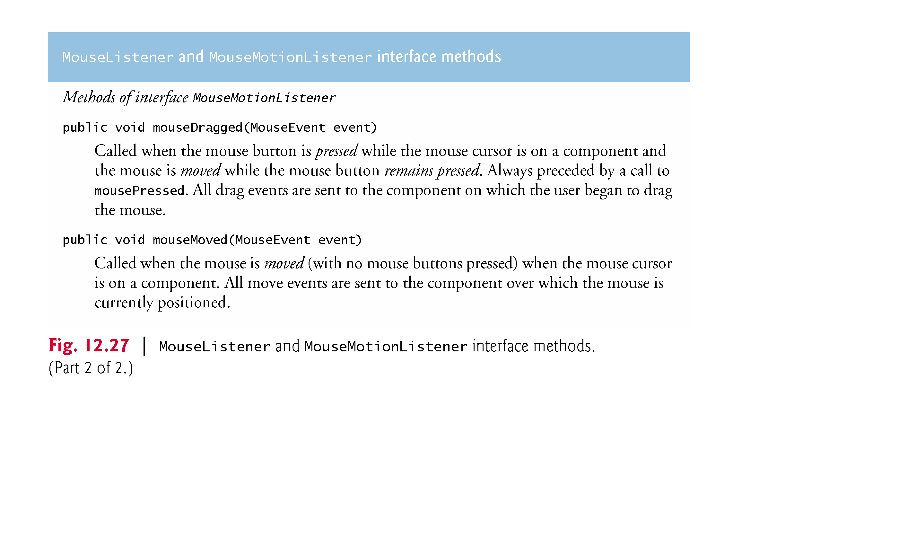

Slide 77
12.14 Mouse Event Handling (cont.)
Each mouse event-handling method receives a MouseEvent object that contains information about the mouse event that occurred, including the x- and y-coordinates of the location where the event occurred.
Coordinates are measured from the upper-left corner of the GUI component on which the event occurred.
The x-coordinates start at 0 and increase from left to right. The y-coordinates start at 0 and increase from top to bottom.
The methods and constants of class InputEvent (Mouse-Event’s superclass) enable you to determine which mouse button the user clicked.

Slide 78
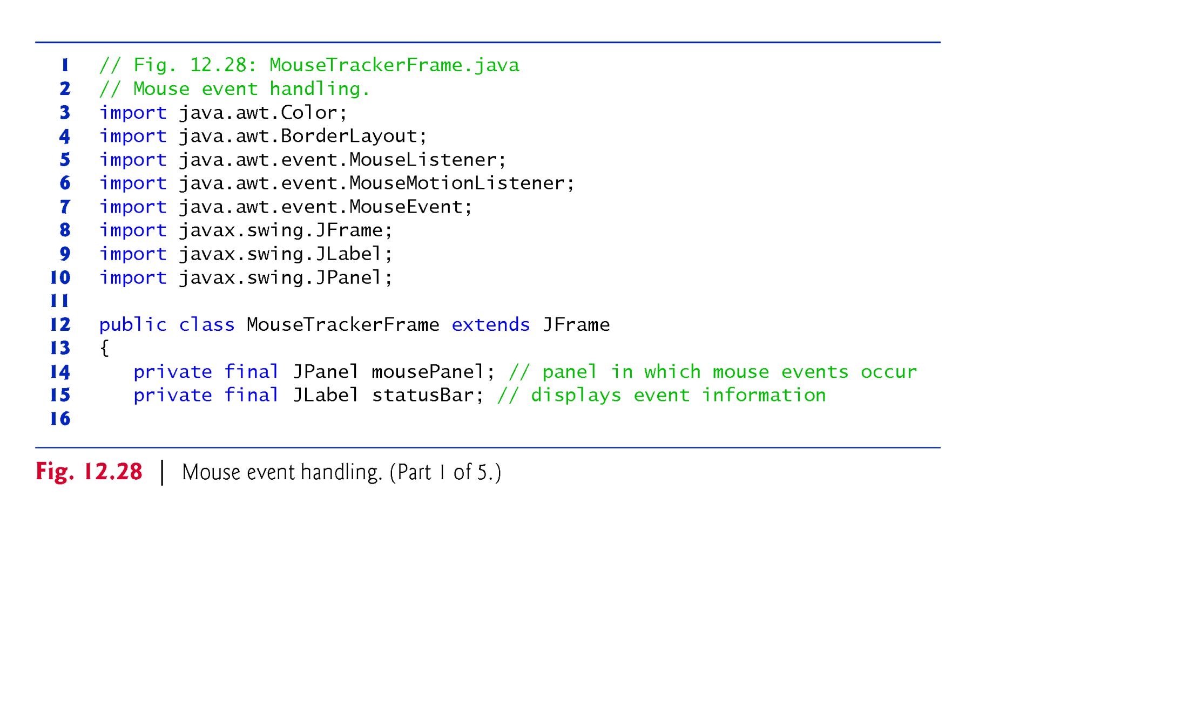

Slide 79
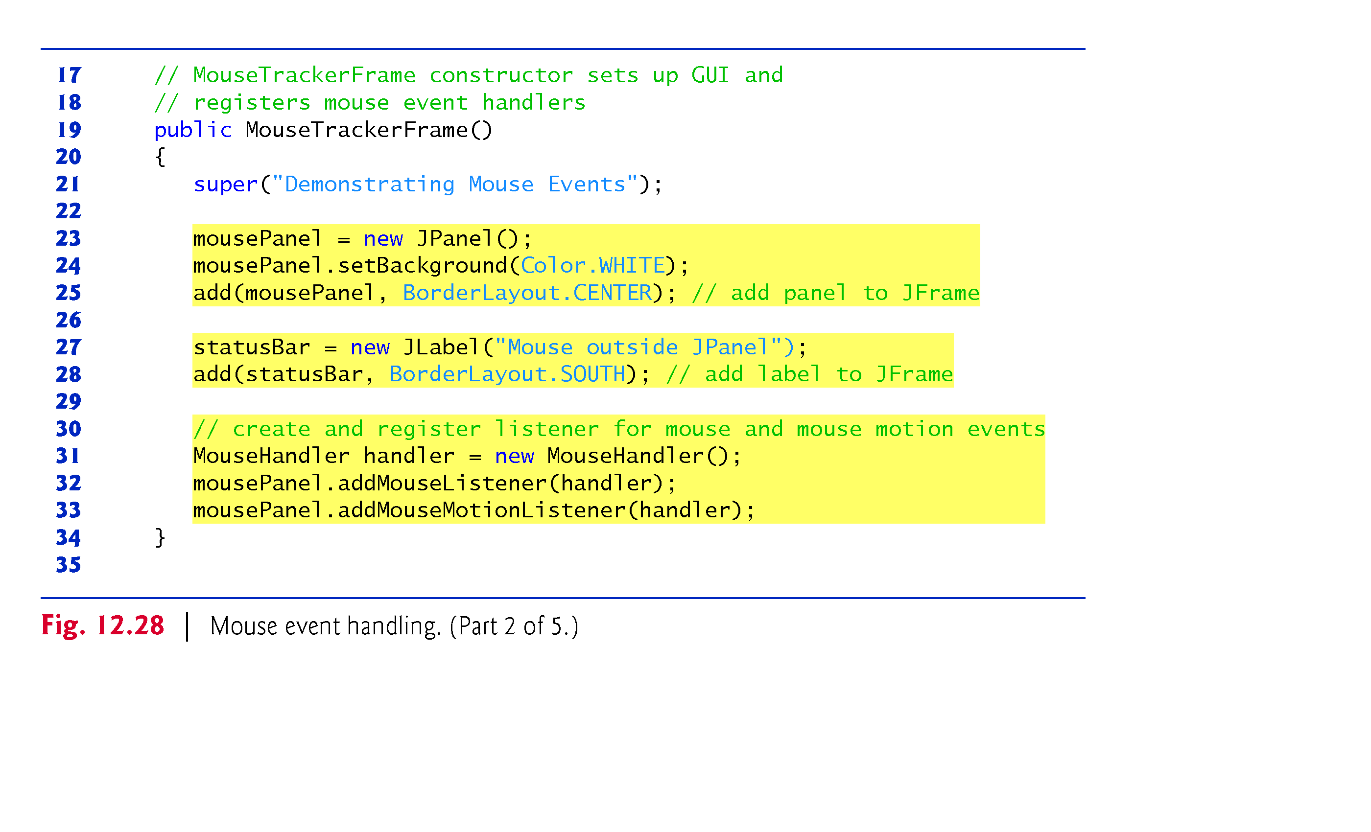

Slide 80
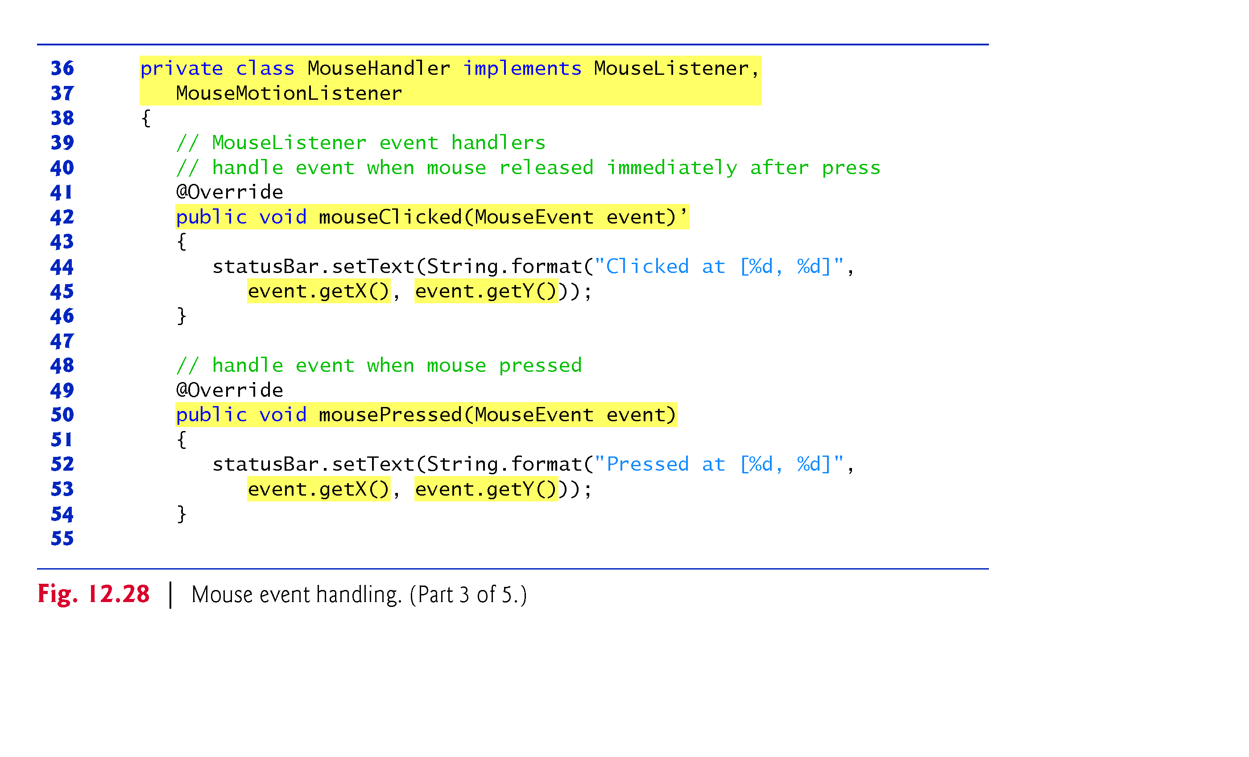

Slide 81
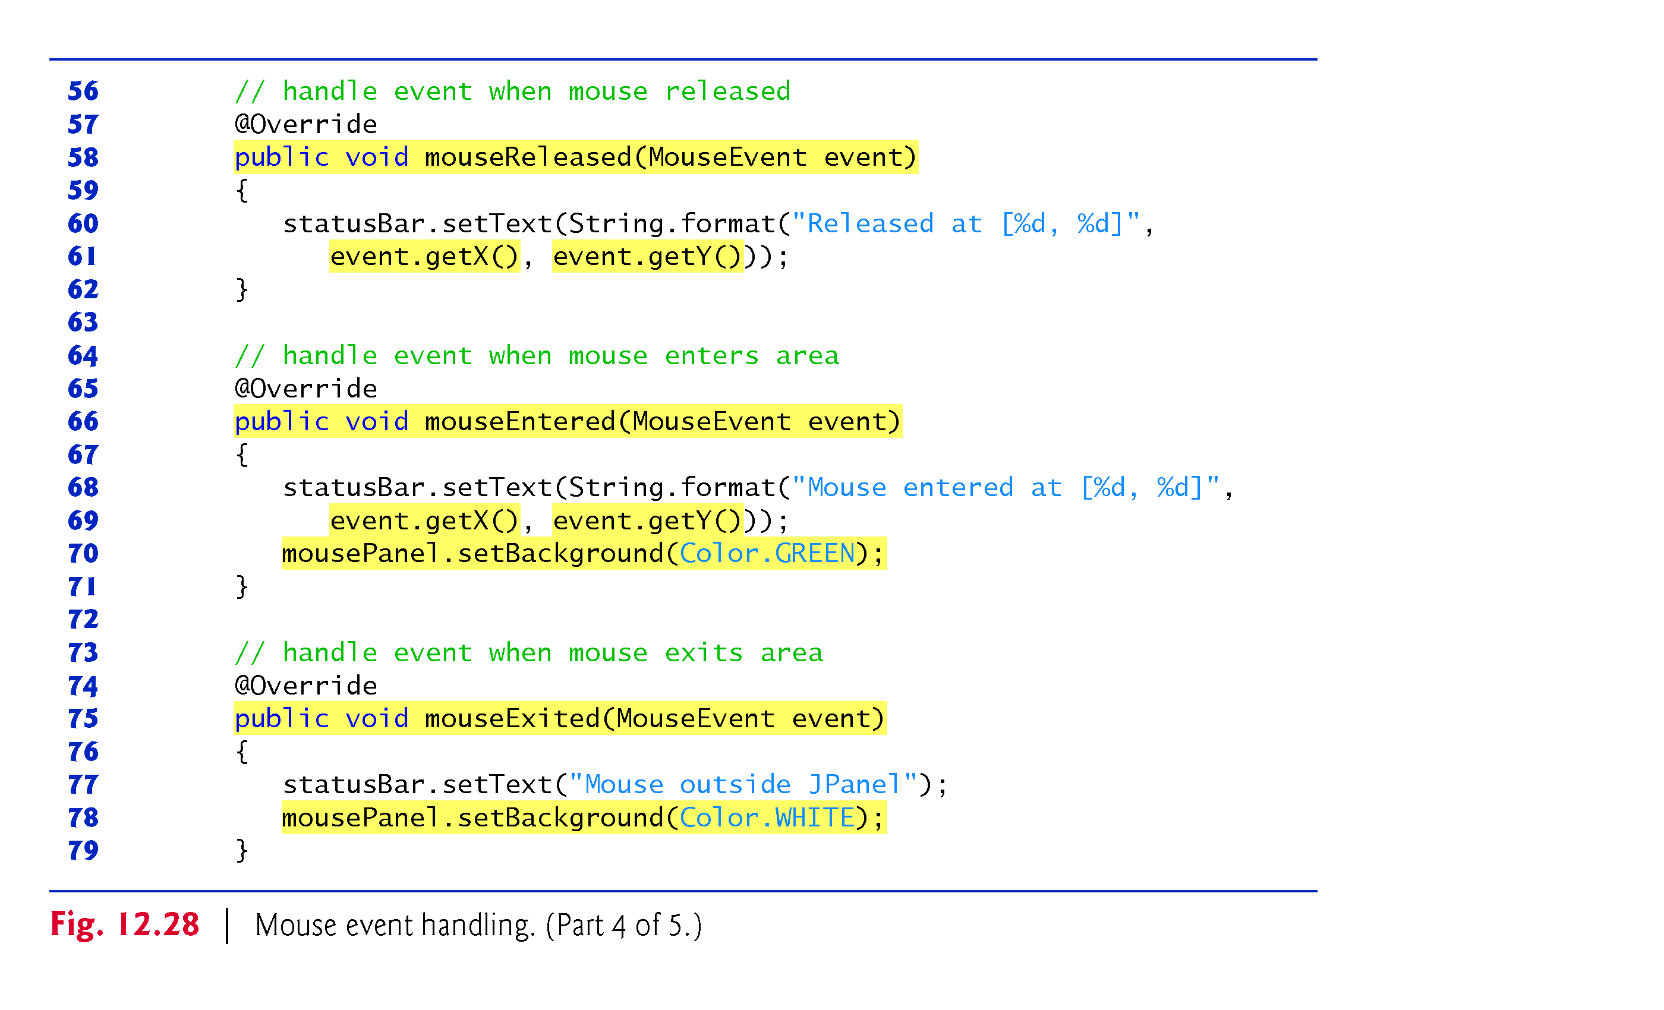

Slide 82
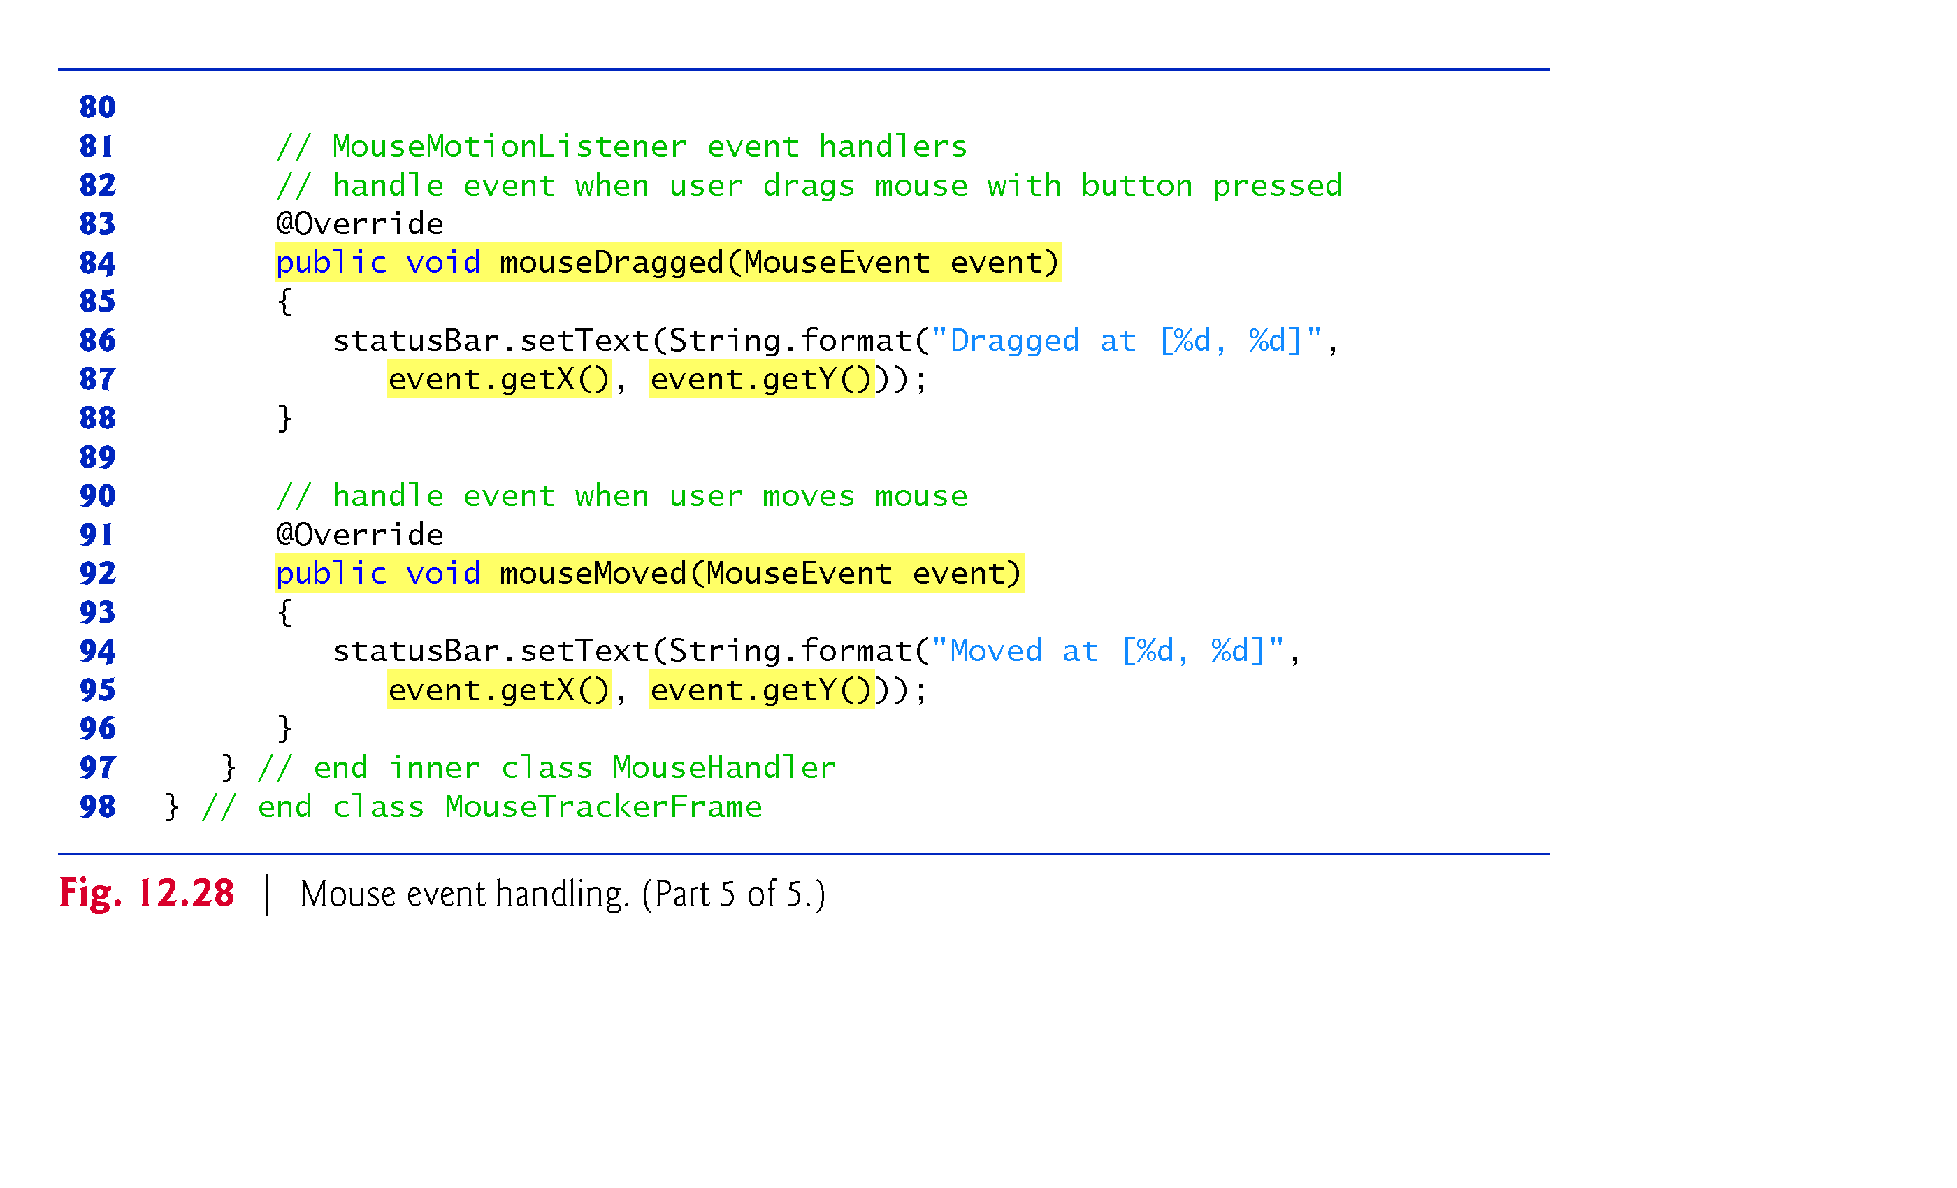

Slide 83
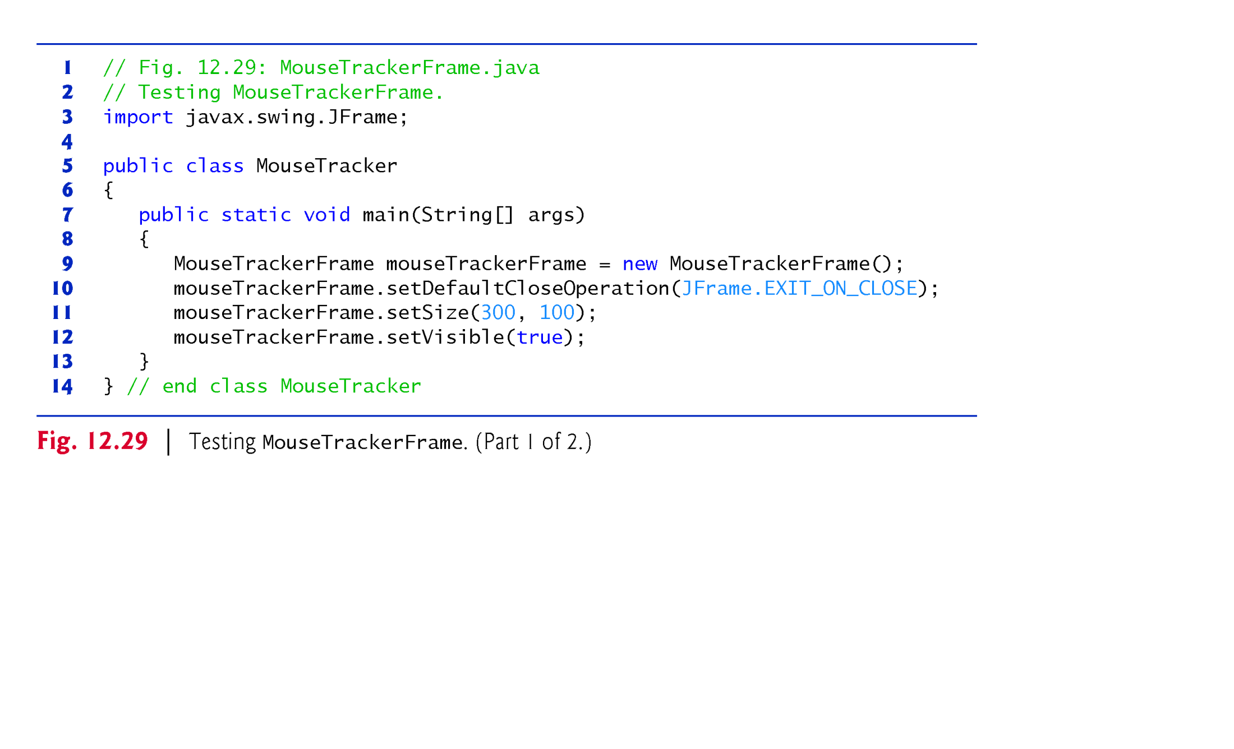

Slide 84
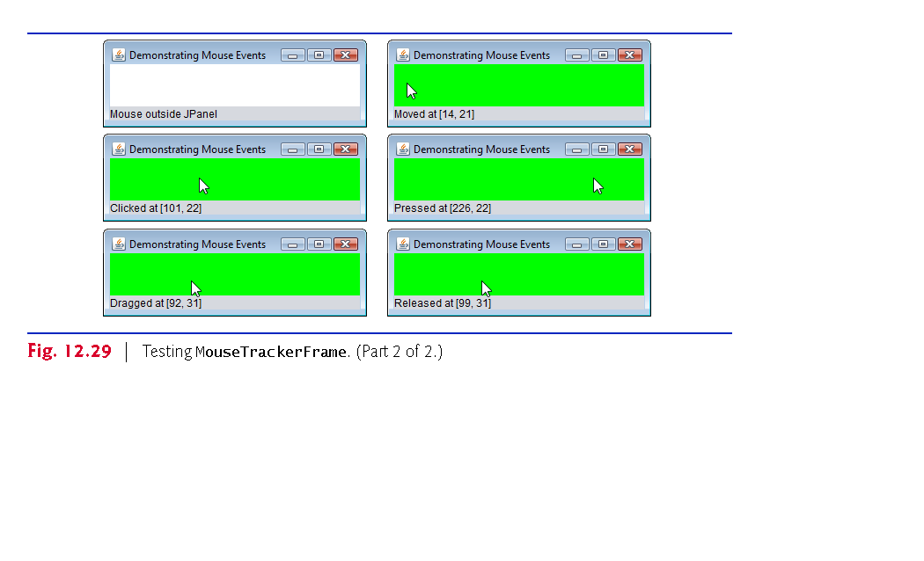

Slide 85
12.17 Key Event Handling
KeyListener interface for handling key events.
Key events are generated when keys on the keyboard are pressed and released.
A KeyListener must define methods keyPressed, keyReleased and keyTyped
each receives a KeyEvent as its argument
Class KeyEvent is a subclass of InputEvent.
Method keyPressed is called in response to pressing any key.
Method keyTyped is called in response to pressing any key that is not an action key.
Method keyReleased is called when the key is released after any keyPressed or keyTyped event.

Slide 86
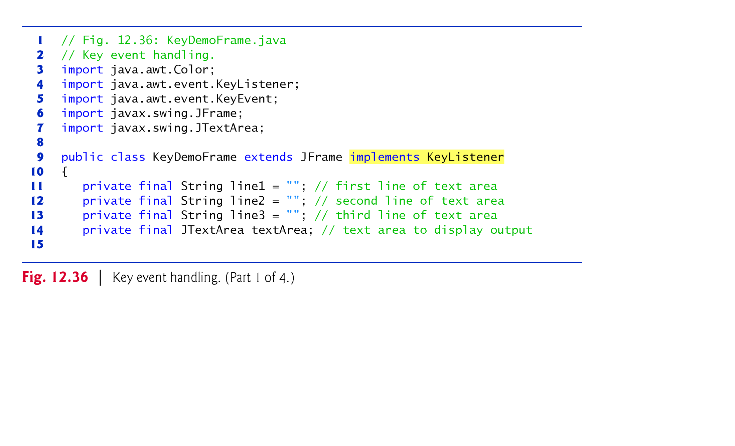

Slide 87


Slide 88


Slide 89


Slide 90


Slide 91


Slide 92
12.18 Introduction to Layout Managers
Layout managers arrange GUI components in a container for presentation purposes
Can use for basic layout capabilities
Enable you to concentrate on the basic look-and-feel—the layout manager handles the layout details.
Layout managers implement interface LayoutManager (in package java.awt).
Container’s setLayout method takes an object that implements the LayoutManager interface as an argument.

Slide 93
12.18 Introduction to Layout Managers (cont.)
There are three ways for you to arrange components in a GUI:
Absolute positioning
Greatest level of control.
Set Container’s layout to null.
Specify the absolute position of each GUI component with respect to the upper-left corner of the Container by using Component methods setSize and setLocation or setBounds.
Must specify each GUI component’s size.

Slide 94
12.18 Introduction to Layout Managers (cont.)
Layout managers
Simpler and faster than absolute positioning.
Makes your GUIs more resizable.
Lose some control over the size and the precise positioning of each component.
Visual programming in an IDE
Use tools that make it easy to create GUIs.
Allows you to drag and drop GUI components from a tool box onto a design area.
You can then position, size and align GUI components as you like.

Slide 95


Slide 96
12.18.1 FlowLayout
FlowLayout is the simplest layout manager.
GUI components placed from left to right in the order in which they are added to the container.
When the edge of the container is reached, components continue to display on the next line.
FlowLayout allows GUI components to be left aligned, centered (the default) and right aligned.

Slide 97


Slide 98


Slide 99


Slide 100


Slide 101


Slide 102


Slide 103
12.18.1 FlowLayout (cont.)
FlowLayout method setAlignment changes the alignment for the FlowLayout.
FlowLayout.LEFT
FlowLayout.CENTER
FlowLayout.RIGHT
LayoutManager interface method layoutContainer (which is inherited by all layout managers) specifies that a container should be rearranged based on the adjusted layout.

Slide 104
12.18.2 BorderLayout
BorderLayout
the default layout manager for a Jframe
arranges components into five regions: NORTH, SOUTH, EAST, WEST and CENTER.
NORTH corresponds to the top of the container.
BorderLayout implements interface LayoutManager2 (a subinterface of LayoutManager that adds several methods for enhanced layout processing).
BorderLayout limits a Container to at most five components—one in each region.
The component placed in each region can be a container to which other components are attached.

Slide 105


Slide 106


Slide 107


Slide 108


Slide 109


Slide 110


Slide 111
12.18.3 GridLayout
GridLayout divides the container into a grid of rows and columns.
Implements interface LayoutManager.
Every Component has the same width and height.
Components are added starting at the top-left cell of the grid and proceeding left to right until the row is full. Then the process continues left to right on the next row of the grid, and so on.
Container method validate recomputes the container’s layout based on the current layout manager and the current set of displayed GUI components.

Slide 112


Slide 113


Slide 114


Slide 115


Slide 116
12.19 Using Panels to Manage More Complex Layouts
Complex GUIs often require that each component be placed in an exact location.
Often consist of multiple panels, with each panel’s components arranged in a specific layout.
Class JPanel extends JComponent and JComponent extends class Container, so every JPanel is a Container.
Every JPanel may have components, including other panels, attached to it with Container method add.
JPanel can be used to create a more complex layout in which several components are in a specific area of another container.

Slide 117


Slide 118


Slide 119


Slide 120
12.20 JTextArea
A JTextArea provides an area for manipulating multiple lines of text.
JTextArea is a subclass of JTextComponent, which declares common methods for JTextFields, JTextAreas and several other text-based GUI components.

Slide 121


Slide 122


Slide 123


Slide 124
12.20 JTextArea
A JTextArea provides an area for manipulating multiple lines of text.
JTextArea is a subclass of JTextComponent.

